Slide 1
EOCT Review
Expansion – Civil War

Slide 2
Northwest Ordinance - 1785
Following the Revolutionary War many Americans wanted to move westward
This ordinance provided an orderly way to survey and distribute land west of the Appalachian Mountains
It created townships of 6 square miles each composed of 36 square mile sections – one had to be reserved for education

Slide 3
Jefferson and the Louisiana Purchase
Napoleon (France’s emperor) wanted to pull out of the New World – they had been overthrown by settlers on Santo Domingo (in the Caribbean)
Jefferson wanted the U.S. to purchase the city of New Orleans (a critical port at the mouth of the Mississippi River)
France controlled an enormous swath of land in the central part of North America
Napoleon offered to sell the entire territory for $15 million
The addition of this area doubled the size of U.S. territory

Slide 4
Louis and Clark
Jefferson authorized an expedition to explore the new Louisiana Territory and west to the Pacific Ocean
He appointed Lewis and Clark, along with 48 men
They brought back a wealth of scientific and geographic knowledge, and were the first white men to map this region of the continent

Slide 5
War of 1812
The U.S. declared war on Britain because of:
Trade restrictions
Impressment of American naval personnel
Support of Native Americans against the U.S.
Battles were fought at sea and on land – especially around the Great Lakes
The British burned Washington D.C. in 1814
A truce was called and a treaty signed in 1815, shortly before the U.S. defeated the British in the Battle for New Orleans
This win raised American spirits and ushered in the Era of Good Feelings
The Star Spangled Banner was written during this war

Slide 6
The Erie Canal
This canal was built to connect the Hudson River in Albany, New York with Lake Erie (the easternmost Great Lake)
It was the first and most successful artificial waterway – made New York City a major port
Its success led to others that eventually served to link every major waterway system east of the Mississippi River

Slide 7
The Monroe Doctrine - 1823
Around 1810, national revolutions had begun in Latin America.
Leaders like San Martin and Simon Bolivar declared independence from the European nations that had colonized them
American leaders feared that European governments might try to restore royal power
President Monroe declared Latin American colonization was over and warned Europeans to stay out of the business of Western Hemisphere nations

Slide 8
The Industrial Revolution
Began in England with the factory system and mechanization of tools
Meant that goods could be made quicker and more efficiently, under one roof instead of piece by piece or handmade
Raw materials from colonies around the world were brought first to England, then, later to America, to be made into finished products
Changed the way of life – labor, unions, business

Slide 9
Eli Whitney - inventor
Cotton gin
Milling machine
Interchangeable parts became important
Also worked on firearms

Slide 10
Manifest Destiny
Belief that America was destined to eventually expand from the Atlantic to the Pacific
Came from a rising sense of nationalism (pride in your country) and that the ideals of liberty should be shared
The explorations of Lewis and Clark spurred this, as did opening of the Oregon Territory

Slide 11
The Temperance Movement
Began in the late 1800s as a push to limit excesses in consumption of alcoholic beverages and intoxication – blamed this for social problems like poverty and crime
Encouraged moderation or abstinence
Was supported by churches
Many states passed liquor laws

Slide 12
Abolitionism
The anti-slavery movement that grew during the early 1800s
The American Colonization Society established the African country of Liberia in 1830 as a place for freed slaves to go (few did)
Petitioned Congress to abolish slavery
Sought to prevent the spread of slavery as new states were added to the union

Slide 13
Abolitionism
William Lloyd Garrison
Started the newspaper The Liberator
Frederick Douglas
An escaped slave; began speaking and published the newspaper the North Star
Grimke Sisters
Traveled and spread personal stories of slavery (family owned them)
Also supported women’s rights

Slide 14
Public Schools
The movement began during the early 1800s
Some wanted free schools for all to teach skills needed to become successful in the republic: thrift, order, discipline, democracy
Others wanted to use them for social control (Americanize immigrants; spread the Protestant religion; solve problems of urbanization)
Colleges grew faster in the beginning than did public primary and secondary schools

Slide 15
The Seneca Falls Convention
A meeting of women in New York in 1848
Beginning of the modern feminist movement
Elizabeth Cady Stanton
Sought voting rights (but were ridiculed)

Slide 16
Jacksonian Democracy
Also known as the Age of Jackson
His party was the Democratic Republicans
Marked a transformation in American political life – became more egalitarian
Broadening of the electorate – the “common man” was now a significant part of the voting populace (all white males could vote)
Jackson was a man of the people – a typical self-made Westerner; he ran the government through a “Kitchen Cabinet” of untrained supporters

Slide 17
The Missouri Compromise of 1820
The Missouri Territory applied for statehood in 1819
Slavery was already spreading through the Louisiana Purchase area but another slave state would shift the balance of power in Congress to the South
Henry Clay proposed a compromise:
Missouri could enter as a slave state
Maine would enter as a free state
No slave states could enter the union north of the Missouri’s southern boundary

Slide 18
The Nullification Crisis
Congress passed a tariff in 1828 that imposed higher import taxes on many goods needed by Southern planters
John C. Calhoun (Adams’ current VP and a South Carolinian) anonymously denounced the tariff
Said a state had the right to declare a Federal law null and void if a majority of the state’s people agreed it was unconstitutional
A second tariff was imposed in 1832
Calhoun left his post (now Jackson’s VP) and went home to SC where he ordered customs officials to stop collecting duties at the port of Charleston
President Jackson sent in Federal Troops to enforce the collection and agreed to gradually lower the tariff

Slide 19
John C. Calhoun and sectionalism
Was responsible for fueling the Nullification Crisis which pit Southern interests against the interests of the nation as a whole
Was pro-slavery during Westward expansion – fought for slavery in Texas (west of the Louisiana Purchase)

Slide 20
The Mexican-American War: Background
Texas was part of Mexico since the Mexican revolution for independence from Spain in 1822
The US offered to buy it but Mexico would not sell – but, in order to populate the area and raise $, they offered Americans land grants – this brought thousands to Texas
As taxes increased the American settlers reacted by proclaiming independence from Mexico in 1836
A short war followed – the Mexicans beat the Texans at the Alamo, then the Texans (under Sam Houston) drove back the Mexicans
Texas became an independent nation (cont’d)…

Slide 21
The Mexican-American War (cont’d)
Texas sought annexation into the U.S. but was refused because doing so would incite the slavery issue again (they were finally granted admission in 1845)
The U.S. and Mexico were drawn into war in 1846 because:
American settlers were moving into Mexican lands in the west (especially California)
Mexico was still upset about the loss of Texas – they also disputed the boundary
The Mexican people had become anti-American (cont’d)…

Slide 22
The Mexican-American War (cont’d)
Americans moved west through New Mexico into California then south into Mexico and also attacked by sea and directly south into Mexico
The American troops were victorious but the Mexicans refused to negotiate at first
The Treaty of Guadalupe-Hidalgo finally ended the war
The Mexican Cession gave the U.S. the current areas of New Mexico, Arizona, and California (with its critical natural harbors)
Because of the new territory, slavery became an issue again

Slide 23
The Wilmot Proviso
A proposed amendment to the Mexican War appropriations bill (passed by the House, rejected by the Senate)
It stipulated slavery would never exist in any territory gained from Mexico
Though it did not pass, it aroused more sectional feelings that continued to build and divide Americans:
Southerners argued that Congress had no power to regulate servitude in territories
Antislavery Northerners argued the Northwest Ordinance and Missouri Compromise of 1820 suggested otherwise

Slide 24
The Compromise of 1850
Southerners fought to prevent the restriction of slavery in the Western territories – especially California and land from the Mexican Cession
Henry Clay developed a compromise:
For the North – California would be admitted as a free state, the New Mexico and Utah Territories would decide the slavery issue by popular sovereignty, and slave trade would be abolished in the District of Columbia (cont’d)…

Slide 25
The Compromise of 1850 (cont’d)
For the South – the Fugitive Slave Law was strengthened, Congress would not control interstate slave trade, and slavery itself would not be abolished in D.C.
Sectional harmony was restored – temporarily!

Slide 26
The Kansas-Nebraska Act
The strengthened Fugitive Slave Law upset many in the North (they were required by law to help return runaway slaves)
Harriet Beecher Stowe penned Uncle Tom’s Cabin which further outraged those opposed to slavery
In 1854, Senator Stephen A. Douglas introduced a bill to organize the territories of Kansas and Nebraska to facilitate building of a transcontinental RR
In order to get support from Southern senators he included a provision to repeal the Missouri Compromise
And suggested the issue of slavery in these territories be decided by popular sovereignty

Slide 27
Popular Sovereignty
Nebraska voted to remain a free state
Kansas was a different situation
Northerners and Southerners began sending people to settle the territory to promote their divergent views
This led to fighting and the death of around 200 people (“Bleeding Kansas”)
Ultimately, Kansas was not admitted until 1861 (following Southern secession)

Slide 28
The Dred Scott Decision
Dred Scott was a Missouri slave who’s master was an Army doctor – he spent several years with this doctor into the free territory of Wisconsin
The doctor died and Dred Scott filed suit claiming he should be free since he lived in a free
The Supreme Court ruled that not only was he not “free” but he did not even have the right to file suit since he was a slave
This decision provoked outrage among abolitionists

Slide 29
John Brown and Harper’s Ferry
John Brown sought to start a slave uprising by arming slaves and encouraging them to revolt
He was supported and financed by several Northern abolitionists
He broke into the Federal Arsenal at Harper’s Ferry, Virginia, in order to get weapons.
Brown was surrounded, captured, and eventually hanged for treason
Though not all Northerners supported Brown’s actions, many Southerners became afraid that this type of action would spread

Slide 30
The Gettysburg Address
One of the most well known speeches in U.S. history
Delivered by Abraham Lincoln in 1863 – during the Civil War
The words invoked the principles of equality in the Declaration and redefined the Civil War as a struggle for freedom and democracy, ensuring that:
“…a government of the people, by the people, and for the people, shall not perish from the earth.”

Slide 31
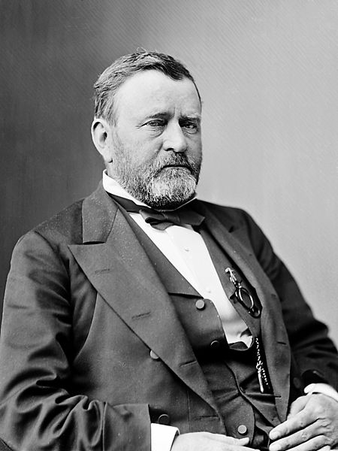
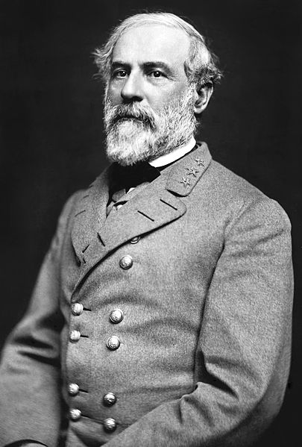
Major Civil War People
Ulysses S. Grant
Robert E. Lee
Commander of the Union forces for most of the war
Commander of the Confederate forces

Slide 32
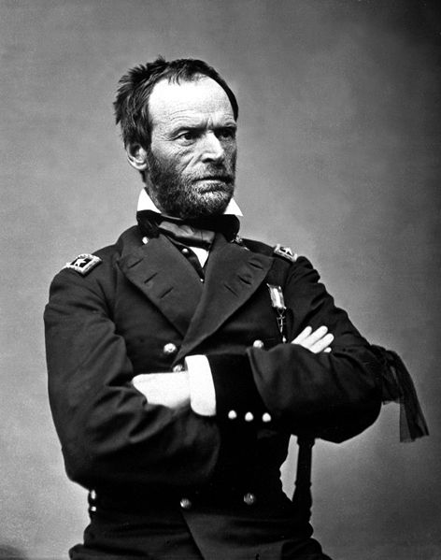
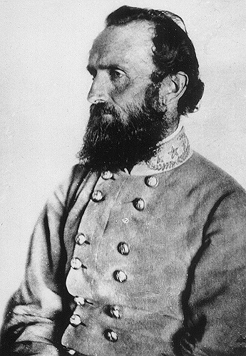
Major Civil War People
William T. Sherman
“Stonewall” Jackson
Union general responsible for “scorched earth” tactics and the March to the Sea
Confederate general victorious in the First Battle of Bull Run and Fredericksburg

Slide 33
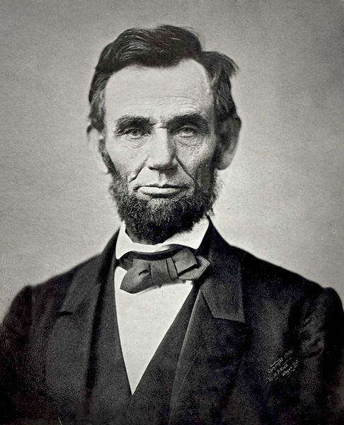
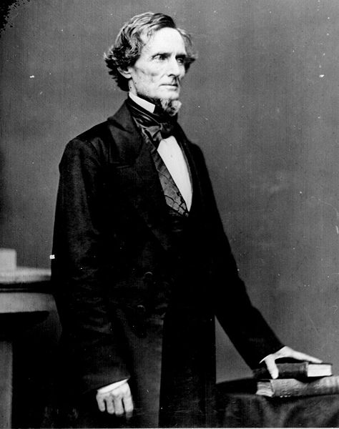
Major Civil War People
Abraham Lincoln
Jefferson Davis
President of the Unites States & the Union
President of the Confederate States of America

Slide 34
Major Battles of the Civil War
Fort Sumter
Antietam
A Union fort off the coast of SC
After SC’s secession, the fort needed supplies – Lincoln ordered a ship to send them
Southerners fired on the fort in order to take it on April 12, 1861
This sparked the Civil War
A short and bloody battle in MD
Bloodiest day of the Civil War – October 3, 1862
Neither side could claim victory

Slide 35
Major Battles of the Civil War
Gettysburg
Vicksburg
July 1863
Union victory over Lee’s army
Battle with most casualties
Turning point of war
Union victory immediately after Gettysburg
Grant’s army split the south in half – cutting off it’s RR supply lines

Slide 36
Major Battles of the Civil War
Battle for Atlanta
Series of battles around Atlanta in 1864
Sherman’s Union troops entered from Tennessee
Ultimately took, then burned, towns from there to Savannah in his March to the Sea

Slide 37
The Emancipation Proclamation
Lincoln’s executive order, issued in January of 1863, proclaimed all slaves living in Confederate states
Did not have an immediate effect, but freed slaves as land was taken during the war
Helped to energize anti-slavery forces during the war

Slide 38
Major Differences between the North and South - Economic
North/Union
South/Confederacy
Factories and industry
Favored taxes that protected them from foreign competition
Large plantations
Opposed taxes that raised prices and hurt sales of farm products

Slide 39
Major Differences between the North and South - Cultural
North/Union
South/Confederacy
Wanted freedom for slaves
Had a mostly urban society
People held factory jobs
Dependent on slave labor
Lived in small villages and on farms

Slide 40
Major Differences between the North and South - Constitutional
North/Union
South/Confederacy
Strong central government
Wanted the nation to stay together
States’ rights – weaker central government and stronger state governments
Seceded from the U.S.

