Slide 1
EOCT Review
Reconstruction - 2001

Slide 2
Reconstruction Venn Diagram
Presidential Reconstruction (Lincoln & Johnson)
Congressional Reconstruction (Radical Republicans)
10% Plan
Pardoned Confederates
No guarantee of political or
social equality
Divided into 5 military districts
Union Generals in charge
Required to ratify 14th amendment (citizenship)
13th amendment
New state constitutions

Slide 3
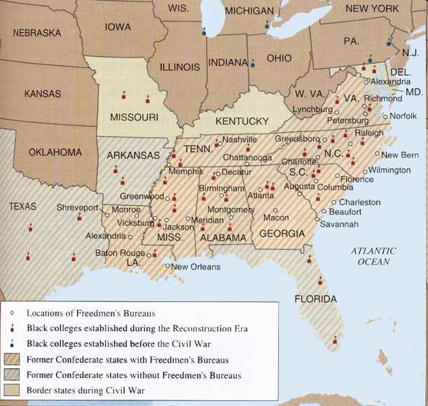
Freedmen’s Bureau
Radical Republican plan supported by Lincoln
Created by Congress in 1865
Goals:
Provided necessities & education for black & white refugees in the South
helped reunite families separated by slavery & war
negotiated fair labor contracts between former slaves & white landowners

Slide 4
Reconstruction Amendments
(1865) Thirteenth - FREE
(1868) Fourteenth - CITIZENS
(1870) Fifteenth - VOTE

Slide 5
Black Codes
Black Code Examples
Generally, black people could not gather after sunset.
Freedmen convicted of vagrancy (not having a job) could be fined, whipped, or sold for a year’s labor.
Freedmen had to sign agreements in January for a year of work. Those who quit in the middle of a contract often lost all that wages they had earned.
Mothers who wanted to stay home and care for their families were forced instead to do farm labor.
- Freed people could rent land or homes only in rural areas.
issued by all southern states
laws that tried to limit rights of African Americans & keep them as landless workers
African Americans could only work in a limited number of occupations: servants or farm laborers

Slide 6
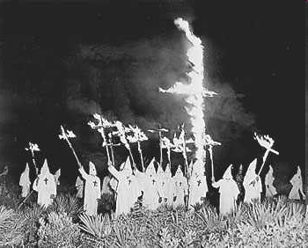
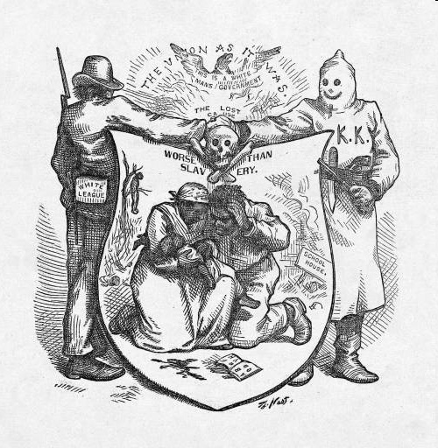
Ku Klux Klan
Formed in Tennessee in 1866
Burned homes, schools, and churches, and beat, maimed, or killed African Americans and their white allies
Dressed in white robes and hoods
Goals: scare freed people from voting

Slide 7
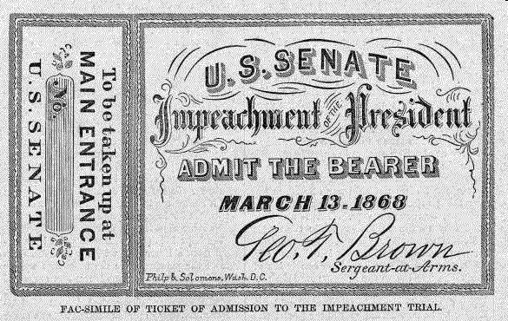
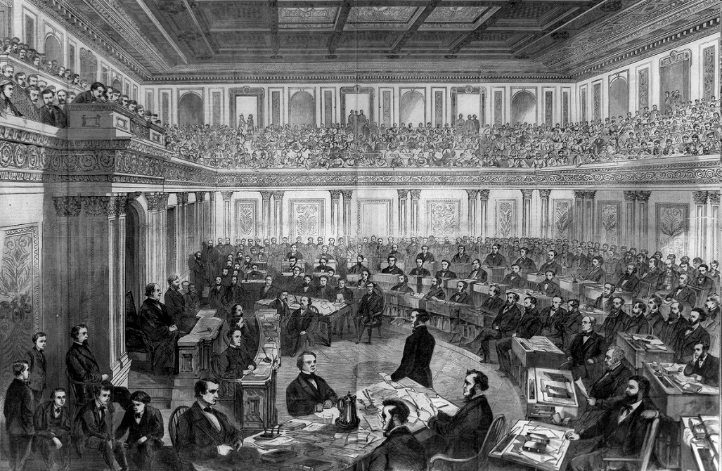
Johnson’s Impeachment
To limit the Pres.’s power, Congress passed Tenure of Office Act – Pres. needed Senate approval to remove certain officials from office
Johnson tried to fire Sec. of War Edwin Stanton (Radical Republican)
House of Reps voted to impeach Johnson (charge him with wrongdoing in office)
Trial in Senate – failed and Johnson stayed President by only one vote

Slide 8
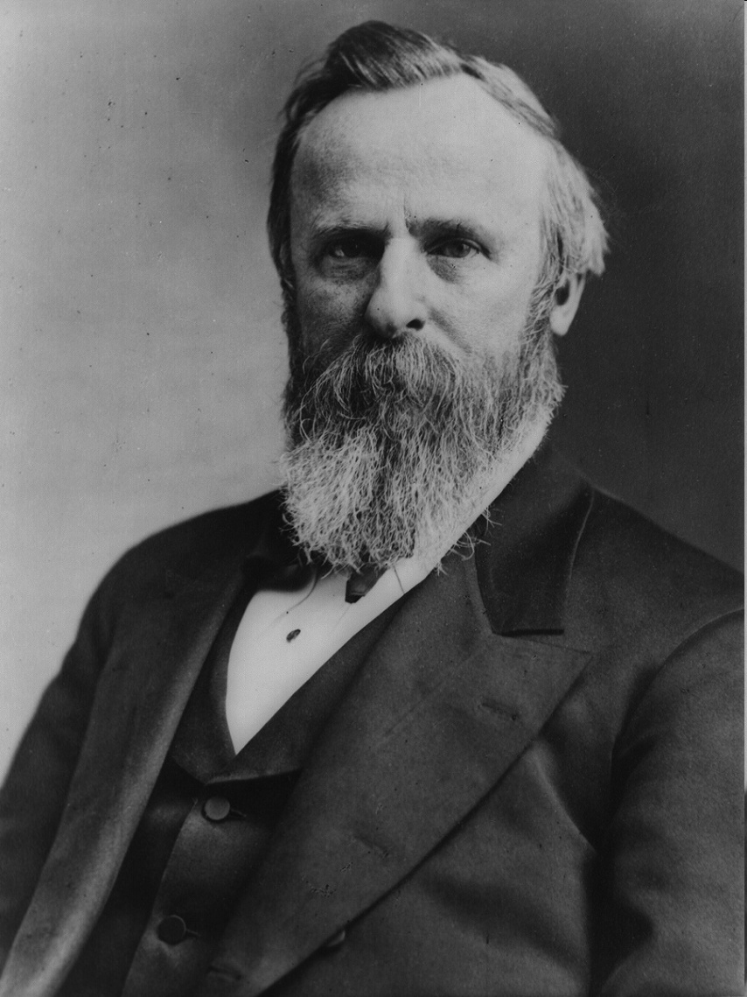
Compromise of 1877
1876 election:
Republican Rutherford B. Hayes
Democrat Samuel Tilden
Tilden won popular vote & Southern states; in recount Hayes won by 1 electoral vote
Compromise of 1877
Hayes elected President
In return, the remaining troops were removed from South = End of Reconstruction

Slide 9
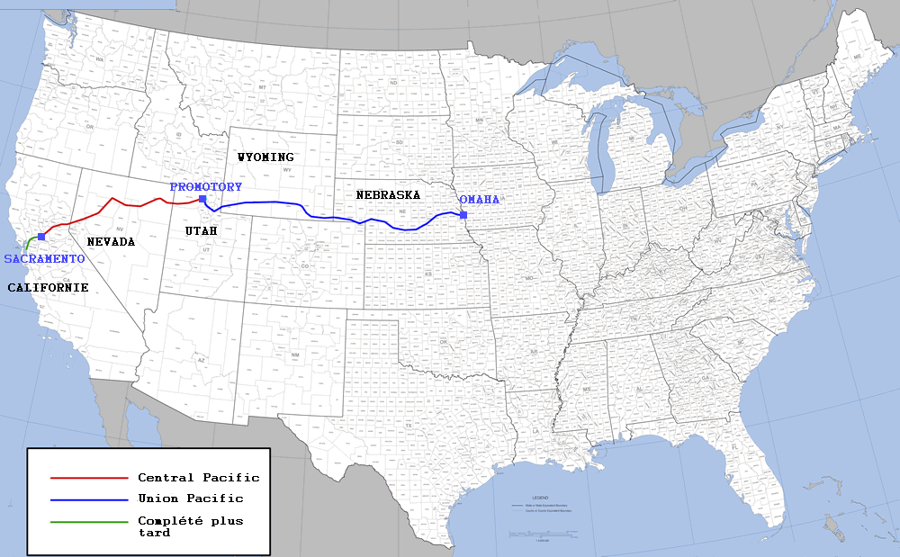
Expansion of Railroads
1st transcontinental RR completed in 1869
Union Pacific – built from E to W (used many Irish laborers)
Central Pacific – built from W to E (used many Chinese laborers)
Met at Promontory Pt, Utah in 1869

Slide 10
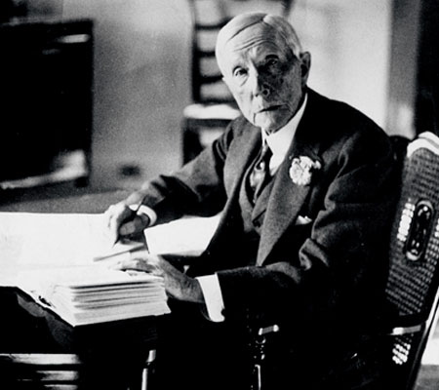
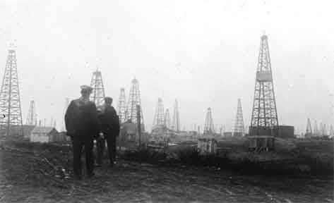
Rockefeller & Standard Oil: Rise of Trusts & Monopolies
John D. Rockefeller Standard Oil Company tycoon
corporations wanted to increase profits:
tried to gain a monopoly – complete control over a product or service
created trusts – group of separate companies that are put under the management of a single group (forms a monopoly)

Slide 11
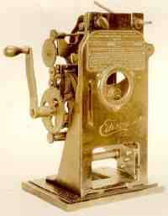
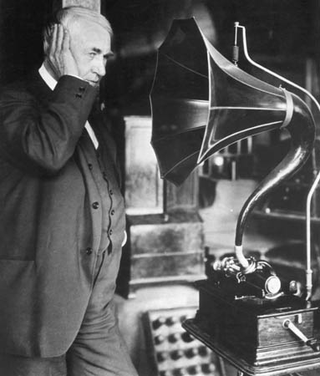
Edison’s New Inventions
Thomas Edison’s Inventions:
Electric light bulb (1880)
Motion pictures (1888) - built the machine needed for filming and projecting motion pictures
Phonograph (1877) – early record player

Slide 12
Who came to America?
“Old” Immigrants
before Civil War (1820-60)
from Northern & Western Europe
mostly skilled workers
most moved onto small towns & farms of North and West
language, customs, religion similar to Americans
faced hostility, but more easily assimilated into American society
“New” Immigrants
after Civil War (1880-1914)
from Eastern & Southern Europe & Asia
mostly unskilled workers
most remained in cities of Northeast – “ethnic islands”
language, customs, religion, appearance different to Americans
faced hostility and suspicion; not easily assimilated

Slide 13
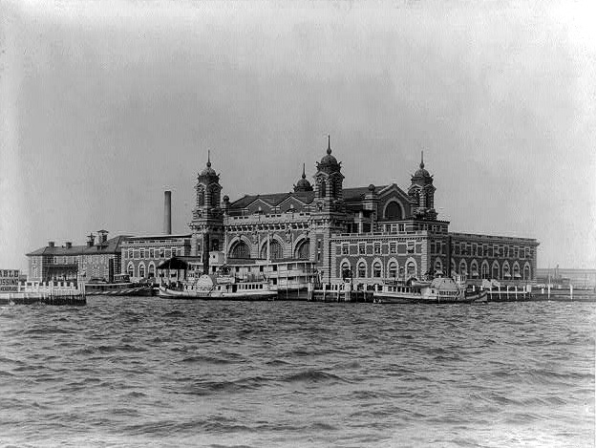
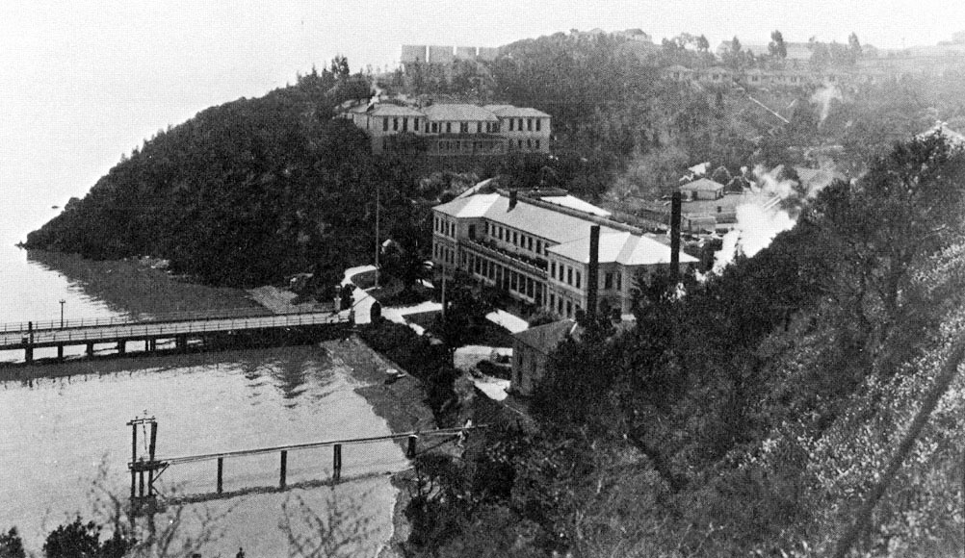
What were the major points of entry for immigrants coming to the United States?
1892 Ellis Island opened in New York Harbor as major immigration station on East coast
1910 Angel Island opened in San Francisco & became a major station on West coast
Ellis Island
Angel Island

Slide 14
The Rise of Organized Labor
Labor Union Membership Who joined? | Founder/Leaders/ Objectives/Demands | Significant activities/success/ failures
American Federation of Labor (1886) Members: only skilled workers; did NOT accept women and blacks | Founder: Samuel Gompers Objectives: improve wages, hours and working conditions; workplaces only hire union members | Success: 1890-1915 wages rose & average work-week declined has survived to present day – merged with CIO in 1955

Slide 15
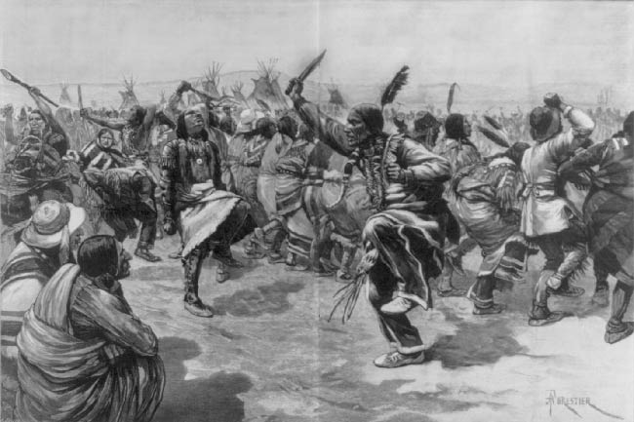
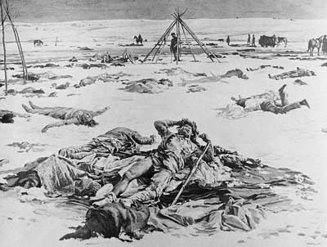
Native American Conflicts: Wounded Knee
Wounded Knee (1890)
U.S. government concerned, ordered arrest of Sitting Bull – he & others were killed when followers tried to rescue him
U.S. troops followed Sioux who escaped – killed more than 100 at Wounded Knee, South Dakota
end of Plains Indian resistance

Slide 16
Industrial Unrest: Pullman Strike
1894 Pullman Strike
Pullman Palace Car Company laid off workers and reduced wages, later shut down plant
Owner: George Pullman
A.R.U. called for a nationwide strike
Halted railroad traffic & mail delivery
President Grover Cleveland sent federal troops to end strike
Debs put in prison (he violated Sherman Antitrust Act)

Slide 17
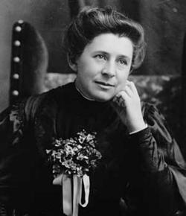
Who were the muckrakers?
journalists and writers
investigated & alerted public to wrongdoing in politics & business, raised social issues
Examples:
Ida Tarbell – A History of the Standard Oil Trust (monopolies & trusts)
Jacob Riis
Ida Tarbell

Slide 18
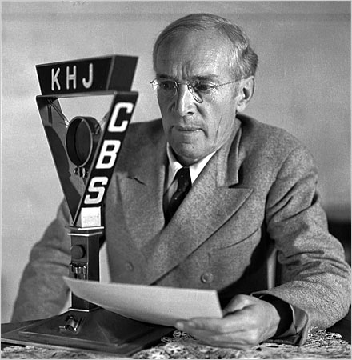
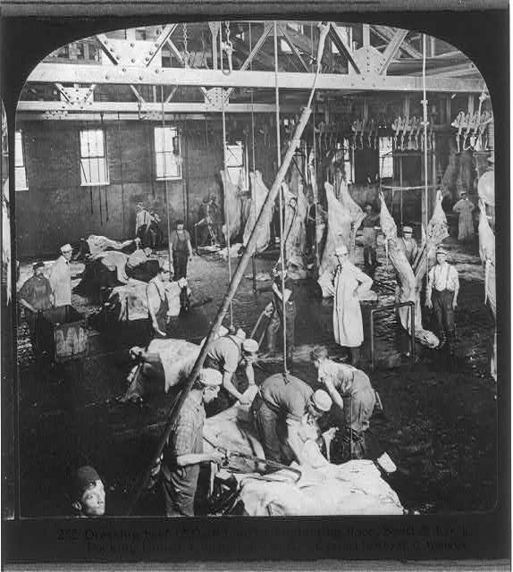
Upton Sinclair’s The Jungle
published 1906
exposed dangerous and unsanitary conditions in Chicago’s stockyards
President Roosevelt read it & got Congress to pass the Meat Inspection Act – provided federal agents to inspect meat sold across state lines & required federal inspection of meat-processing plants

Slide 19
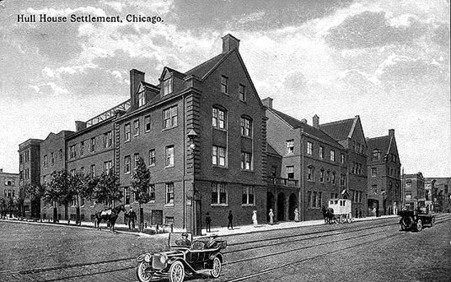
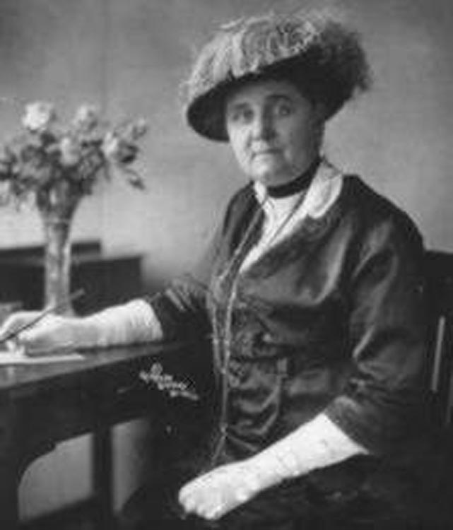
Jane Addams & settlement houses:
opened Hull House, a settlement house in Chicago
settlement houses – community centers organized to provide social services to the urban poor
examples of services provided: gave mothers child care classes, taught English, ran nursery schools and kindergartens, etc.

Slide 20
Jim Crow Laws
Segregation laws enacted in the South after Reconstruction
Plessy v. Ferguson (1896) – upheld the constitutionality of Jim Crow laws; “separate but equal” did not violate Fourteenth Amendment

Slide 21
NAACP
National Association for the Advancement of Colored People formed in 1909
interracial organization founded to abolish segregation & discrimination and to achieve political & civil rights for African Americans
strategy: use courts to challenge unfair laws

Slide 22
Progressive Political Reforms
Initiative – citizens put a proposed new law directly on the ballot
Recall – voters can remove elected officials form office before their terms end
Referendum – process that allows citizens to approve or reject a law passed by a legislature
17th Amendment – direct election of Senators by voters, not state legislatures

Slide 23
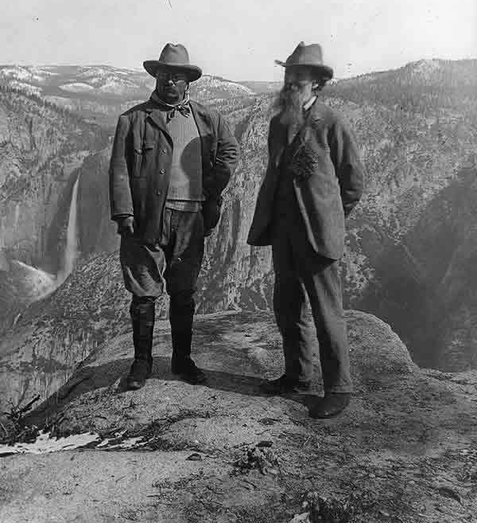
Roosevelt & the Conservation Movement
Congress created U.S. Forest Service
Set aside 200 mill. acres of land for nat’l forests & water projects
National Reclamation Act passed (1902): set aside $ from sale of public lands to fund construction of irrigation systems in states
President Roosevelt and conservationist John Muir at California’s Yosemite National Park in 1903.

Slide 24
Chinese Exclusion Act
1882 Chinese Exclusion Act –
1st immigration restriction in U.S. history
prohibited immigration by Chinese laborers
limited civil rights of Chinese immigrants in U.S.
forbade the naturalization of Chinese residents

Slide 25
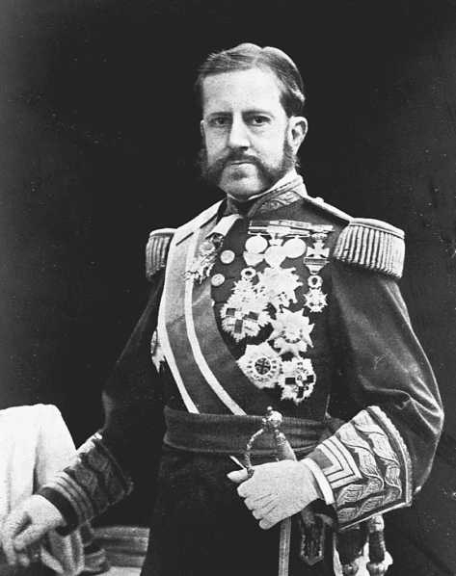
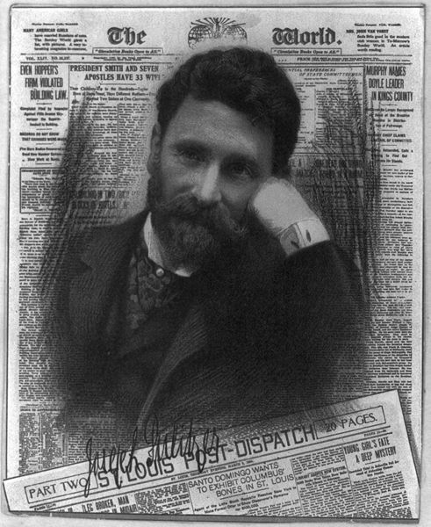
Causes of the Spanish-American War
People of Cuba & Philippines wanted to rebel against Spain
Depression of 1890 in Cuba; 1895 Cubans revolted against Spain
Spanish used harsh tactics against Cubans (Gen. Valeriano “the Butcher” Weyler)
American press (“yellow journalism”) reported cruelties; Pulitzer & Hearst created sympathy for Cubans
American investments & property destroyed during Cuban revolt
“The Butcher” Weyler
Joseph Pulitzer, journalist for New York World

Slide 26
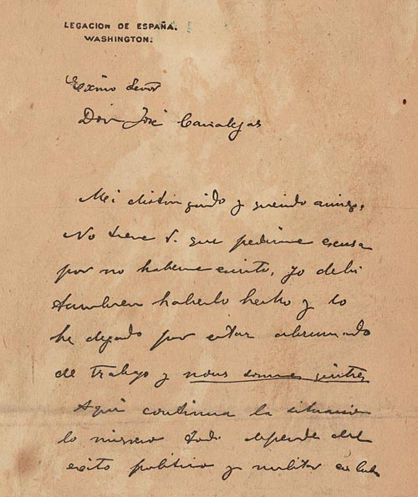
Causes lead to Spanish-American War
Feb 9, 1898 – DeLome Letter printed in Hearst’s Journal – called McKinley weak & stupid
Feb 15, 1898 – USS Maine exploded in Havana harbor killing 266 American sailors; press blamed Spain - “War? Sure!”
McKinley asked Congress to declare war
April 19, Congress declared war & adopted Teller Amendment – US had no intention of annexing Cuba

Slide 27
Effects of the Spanish-American War: Philippine-American War
U.S. annexation of Philippines led to Philippine-American War
led by Emilio Aguinaldo
3 years; 216,000 Filipinos died & 5,000 Americans
1946 - Philippines given independence

Slide 28
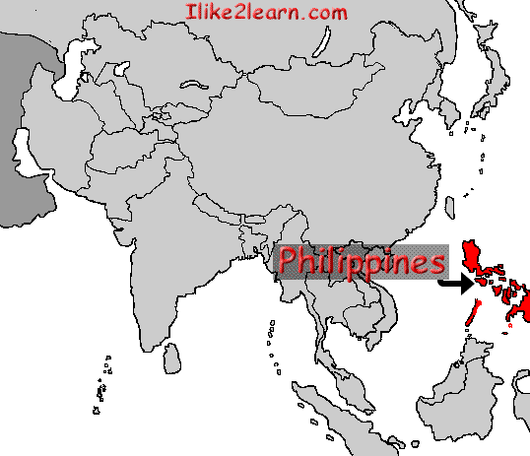
Debate over Expansion
Imperialists supported expansion
Arguments:
Americans needed new frontier
New markets for American manufactured goods
New sources of raw materials
Increase in military power
Spread American ideals: Christianity, democracy, capitalism
American superiority – our “duty”

Slide 29
Debate Over Expansion
Anti-imperialists opposed expansion
Arguments:
Rejected nation’s foundation of “liberty for all”
Faced enough difficulties at home
Threatened democratic foundations (fear of large standing armies)
Racism – might have to absorb people of different races
Expansion would cost too much
Fear of competition in job market; lower wages

Slide 30
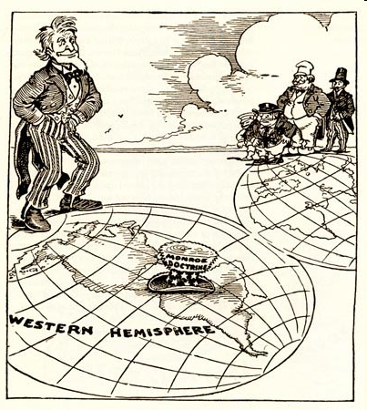
Review: What is the Monroe Doctrine?
Issued by President Monroe in 1823
We (United States) won’t bother you (Europe), you don’t bother us (Western Hemisphere)

Slide 31
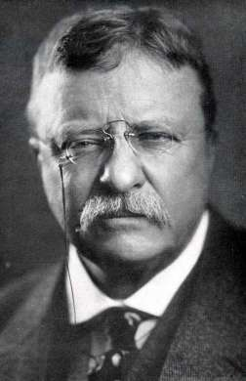
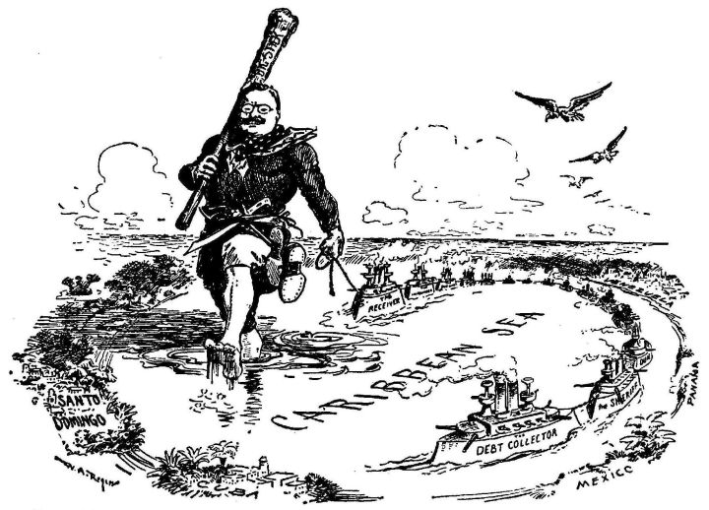
Roosevelt Corollary (To Monroe Doctrine)
Why? Europeans threatened intervention in W. Hemisphere (to collect debts, etc.)
When and how stated? In Dec. 1904 by Roosevelt in message to Congress
Central Message: if intervention in W. Hemisphere necessary, U.S. would intervene, not European nations

Slide 32
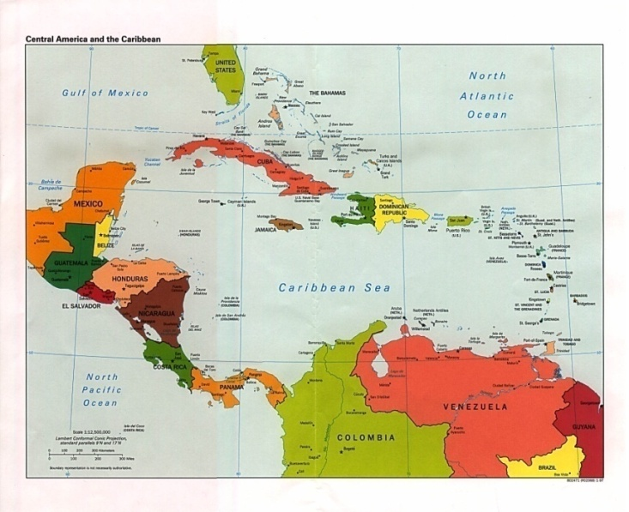
How Did U.S. Acquire Rights to Build the Canal?
Hay-Bunau-Varilla Treaty
signed w/ Panama in 1904
Panama Canal Timeline:
1) 1903: U.S. negotiated
treaty w/ Colombia (Panama part of)
2) Colombian gov’t stalled treaty demanding more
money
3) Roosevelt impatient – supported Panama’s revolt
4) U.S. recognized Panama’s independence,
negotiated treaty w/ Panama ($10 mill; $250,000 yearly lease for 10 mile wide strip)

Slide 33
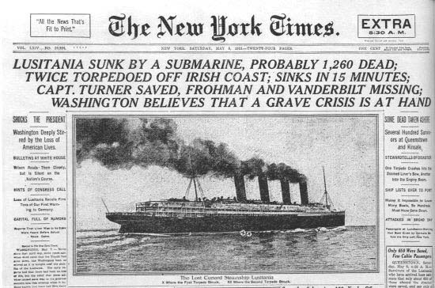
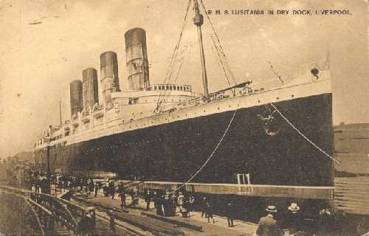
American Enters WWI: British passenger liner Lusitania
128 Americans died

Slide 34
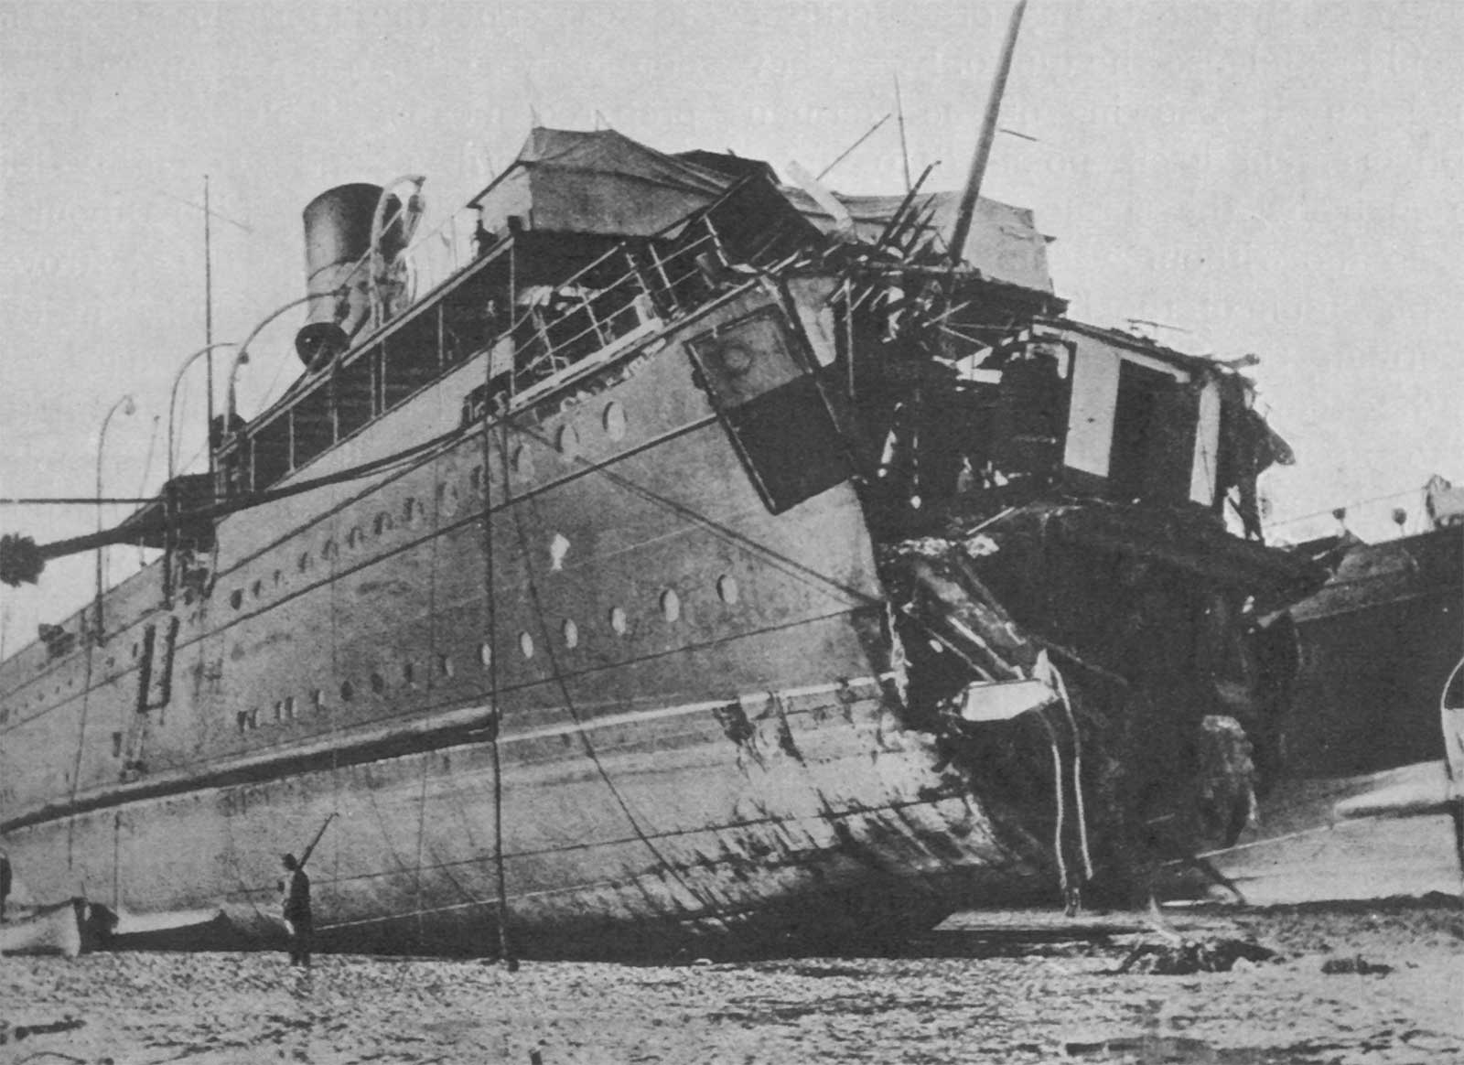
American Enters WWI: French passenger ship Sussex & Sussex pledge

Slide 35
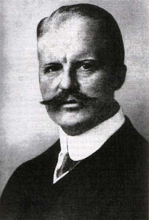
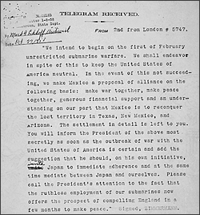
American Enters WWI: Zimmerman Telegram
German Foreign Minister Arthur Zimmerman
Telegram sent to Mexico asking Mexico to declare war on the U.S.

Slide 36
America enters WWI: Zimmerman Telegram
German foreign minister Arthur Zimmerman sent telegram to Mexico with this proposal:
Mexico should declare war on the U.S. if they declare war on Germany
In return, if Germany won war, they would give Mexico back Texas, New Mexico, and Arizona (lands lost in Mexican-American War)
Mexico declined the proposal, but when Germany again announced unrestricted submarine warfare against Great Britain, the U.S. declared war on Germany on April 6, 1917

Slide 37
WWI Home Front
Selective Service Act –
passed by Congress in 1917; authorized draft of men for military service; 2.8 million drafted, 4.8 million served
Women –
won right to vote; moved into the workforce to replace men who were fighting; served as nurses
Government Responses to Opposition:
Espionage Act (1917) - severe penalties for anyone involved in disloyal or treasonable activities or interfering with the war effort
Sedition Act (1918) – illegal to use disloyal or abusive language about American government, Constitution, or military; Socialist leader Eugene V. Debs (ARU) imprisoned for anti-war speech

Slide 38
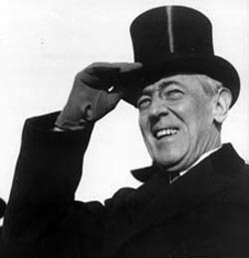
Woodrow Wilson’s Fourteen Points
Fourteen Points - Wilson’s list of terms for resolving WWI and future wars
Key ideas:
“peace without victory”
open diplomacy
freedom of seas and free trade
move toward ending colonialism
self-determination
League of Nations

Slide 39
America Rejects the Treaty
Senate’s issues with the Treaty of Versailles:
concerned about the League of Nations
afraid the treaty could lead the U.S. into a war without the consent of Congress
The United States did NOT ratify the treaty to join the League of Nations.
U.S. foreign policy after rejecting the treaty – isolationism

Slide 40
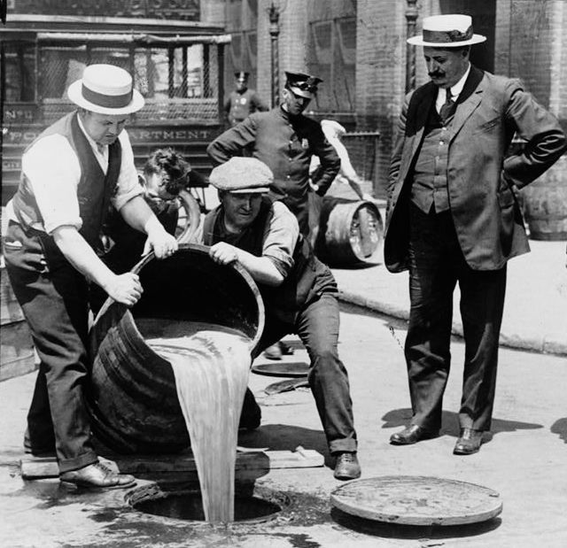
Prohibition – Eighteenth Amendment
Prohibition – the banning of alcoholic beverages
1919 states ratified Eighteenth Amendment – forbade the manufacture, distribution & sale of alcohol in the U.S.

Slide 41
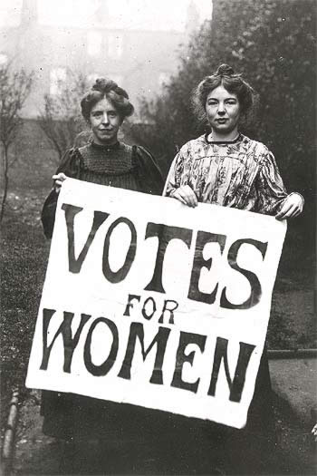
Nineteenth Amendment
Approved by Congress in 1919
Gave women the right to vote

Slide 42
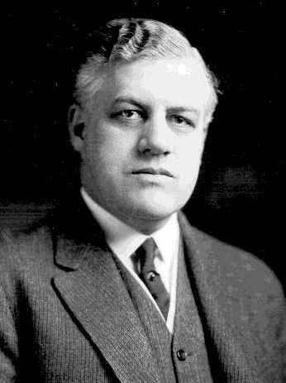
The Red Scare
Red Scare – fear of communists & radicals thought to be planning revolution in U.S.
Attorney General A. Mitchell Palmer led raids against suspected radicals & foreigners using Espionage & Sedition Acts
Palmer & agents accused of using torture to obtain intelligence & collect evidence
General A. Mitchell Palmer – leader of the Palmer Raids

Slide 43
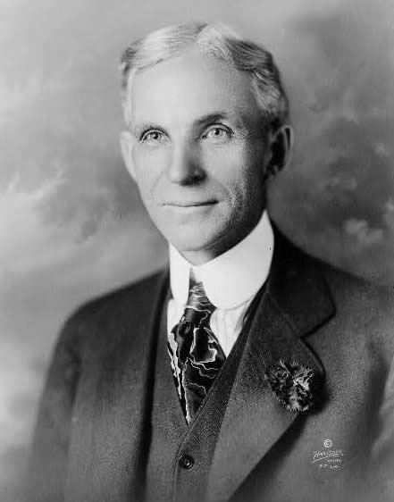
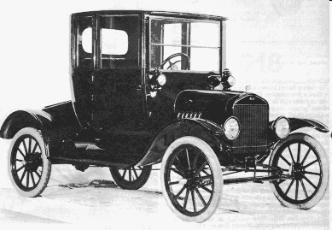
Henry Ford’s Model T
Henry Ford: responsible for much of America’s economic growth
1908 Model T – made cars affordable for ordinary Americans by:
Mass production – used on a larger scale (thousands of parts)
Assembly Lines – opened large factories (esp. in Detroit) and put cars on moving belts; workers added interchangeable parts; reduced manufacture time from 12 hours to 90 minutes

Slide 44
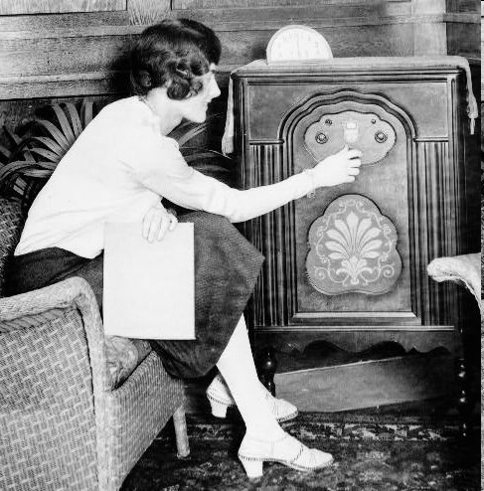
Radio
1920s radios became widespread
news & entertainment broadcasts began
increased the speed with which people gained information
increased national unity

Slide 45
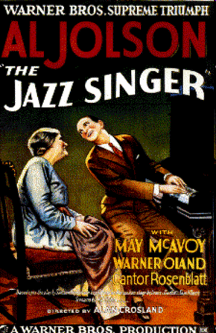
Movies
1920s movies became popular
1927 the first movie with sound, The Jazz Singer
movies with sounds called “talkies”

Slide 46
The Harlem Renaissance
Renaissance is Latin for
“rebirth”
What was the Harlem Renaissance?
period of “rebirth” for African American culture
During this period, African American novelists, poets, and artists celebrated their culture

Slide 47
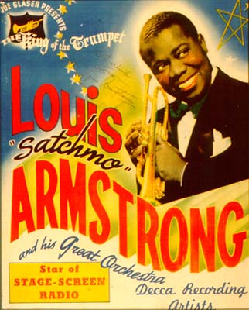
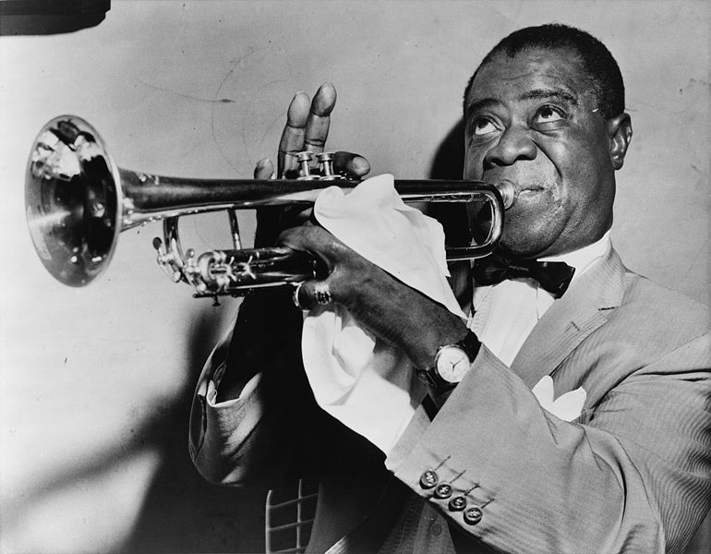
Louis Armstrong
trumpet player – famous for jazz music
nicknamed “Satchmo”
known as the “ambassador of jazz” – traveled to Africa, Asia, & Europe
also pioneered “scat”

Slide 48
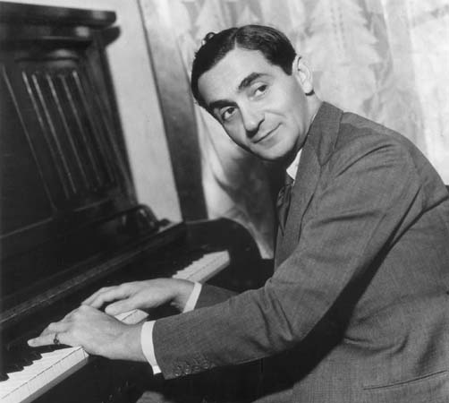
Irving Berlin
songwriter & composer
inspired by jazz music
songs written by Berlin:
“God Bless America”
“Blue Skies”
“I’ve Got My Love to Keep Me Warm”
“White Christmas”
“Happy Holiday”

Slide 49
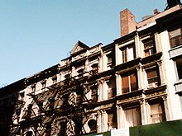
Tin Pan Alley
collection of New York City music publishers & songwriters that dominated popular music
composers like Irving Berlin
commercialization of music --jazz and blues pop-songs & dance numbers popularized
sheet music manufactured for commercial sale & profit
Buildings housed sheet-music publishers that were the center of American popular music in early 1900s.

