Slide 1
Causes of the Depression
Under Consumption
Stock Market Speculation
Overproduction
The Great Depression

Slide 2
The Dust Bowl
Dust Bowl – central & southern Great Plains during 1930s when region suffered dust storms
Causes:
  Severe drought
  Over farming - farmers plowed the plains & eliminated protective layer of grass
  High winds - layers of top soil blown away, leaving dunes of grit & sand

Slide 3
Impact on Americans
Unemployment soared – 25-30% of work force
Bank failures – ¼ of nation’s banks
Business failures – 85,000
Homelessness, hunger widespread
  fed in breadlines, received assistance from charities
  evicted from homes & formed Hoovervilles – makeshift shantytowns of tents & shacks built on public land or vacant lots
Farm foreclosures

Slide 4
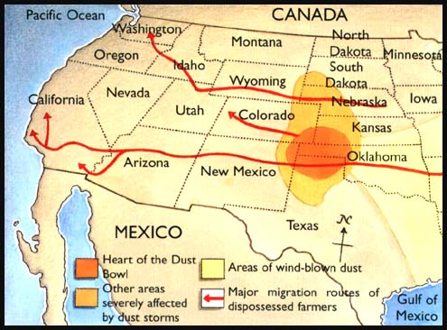
The Dust Bowl
Areas Affected:
  Great Plains
Results:
  Dust storms caused people to leave
  Dust Bowl refugees known as “Okies”
  Results of the migration: rural states lost population, large cities gained more people

Slide 5
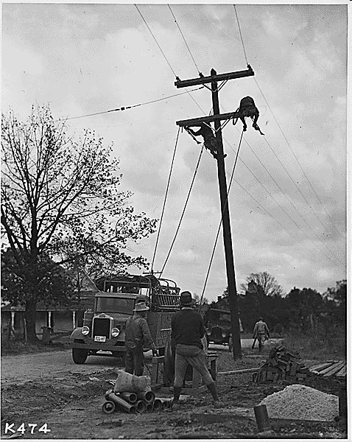
New Deal: TVA
(1933)
Name: Tennessee Valley Authority
Description:
  built dams on TN River to provide hydroelectric power, flood control, & prevent soil erosion
  created jobs & provided cheap electricity for rural areas
  still functioning today

Slide 6
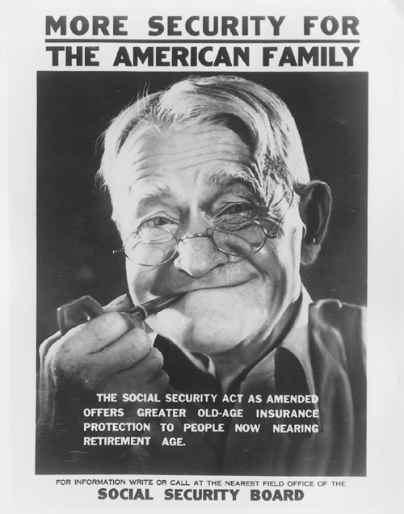
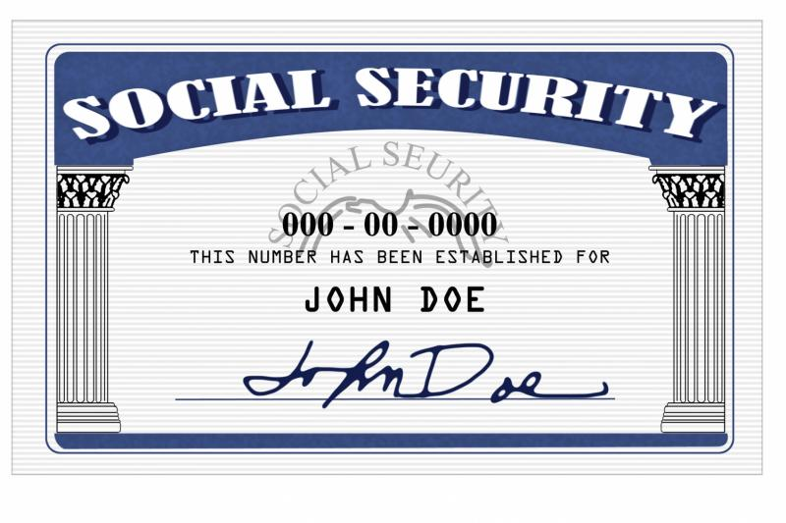
SSA
(1935)
Name: Social Security Act
Description:
  provide security in the form of regular payments to people who could not support themselves
  funded by payroll tax
  3 types of payments:
        old-age pensions
        unemployment insurance
        aid for dependent children & disabled

Slide 7
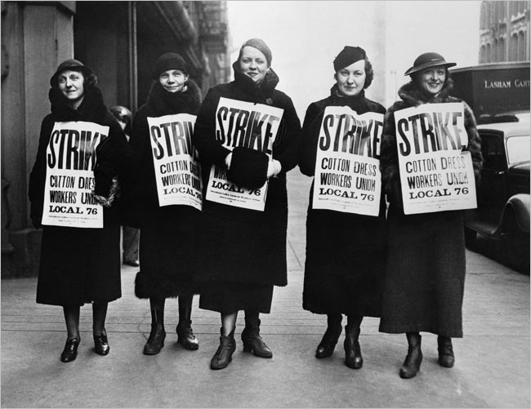
Wagner Act
(1935)
guaranteed unions collective bargaining rights
outlawed discrimination against workers due to union membership/activities
set up NLRB to enforce law’s provisions

Slide 8
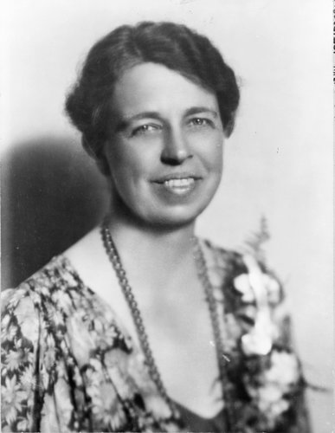
FDR & Eleanor
FDR depended on Eleanor
She traveled & interacted w/ American people serving as FDR’s “eyes & ears”
1933 Bonus Army incident; FDR sends Eleanor instead of army

Slide 9
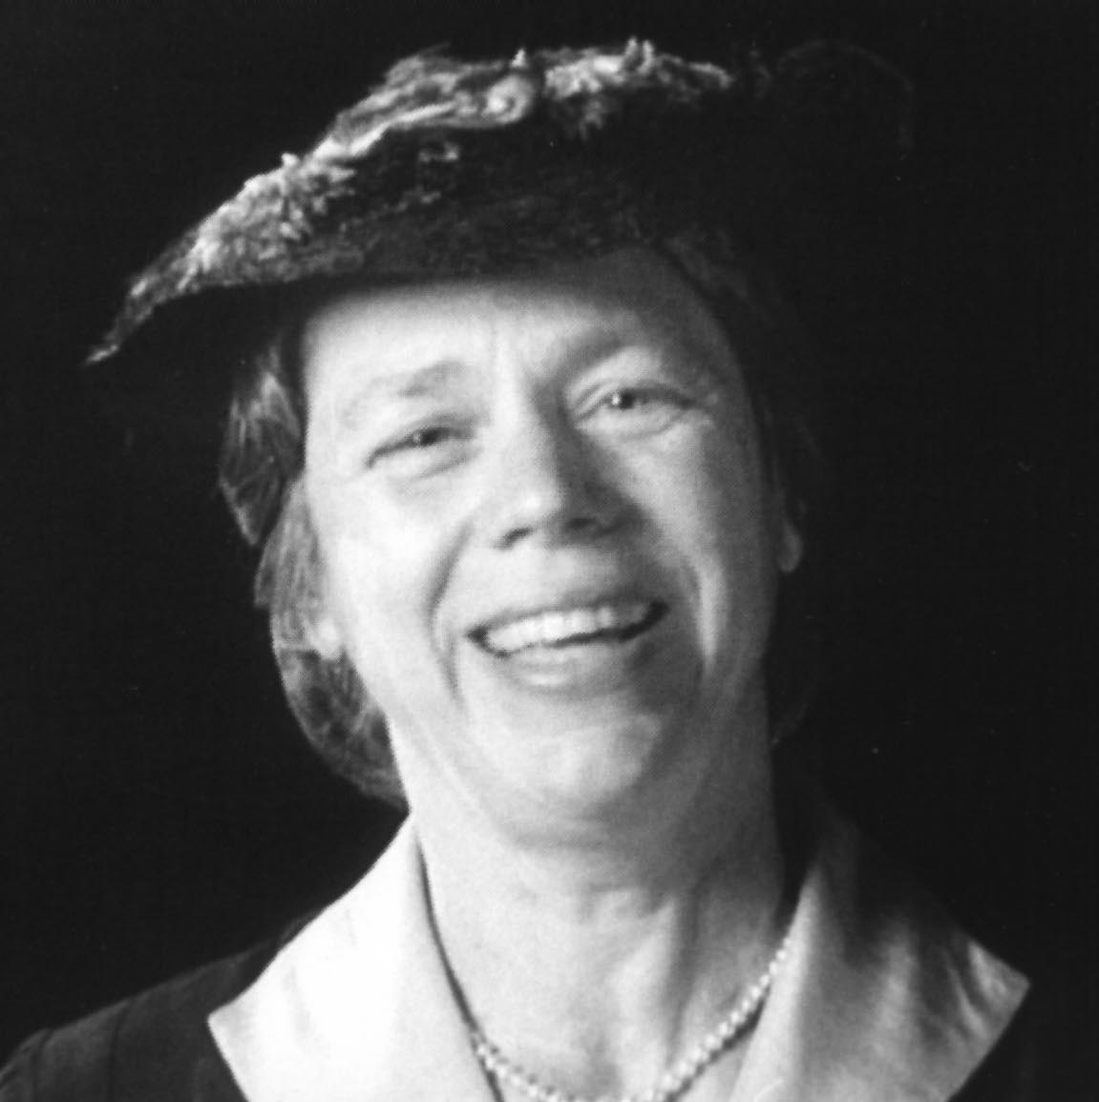
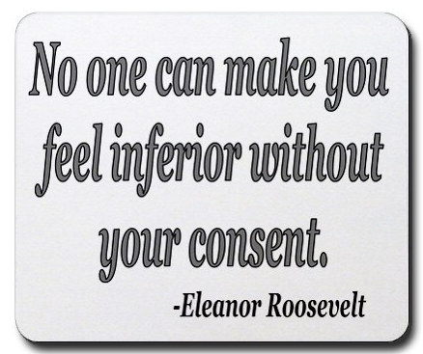
Eleanor
offered advice on policy issues
advocated public health & education, promoted arts, addressed flood control
gave money she earned to charity
Eleanor changed the office of First Lady from a ceremonial role to a position of action & involvement.

Slide 10
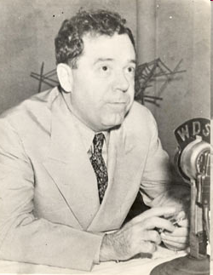
Challenges to Roosevelt’s “New Deal”
LA Senator Huey P. Long criticized New Deal - wanted more help for poor
proposed “Share Our Wealth” program - high taxes on wealthy & large corporations; redistribute their income to poor
made enemies because he ruled state of LA like he owned it – 1935 political enemy assassinated him

Slide 11
FDR’s “Court Packing Bill”
Supreme Court challenges the New Deal:
FDR upset by Supreme Court striking down New Deal programs (AAA)
Roosevelt proposes “packing the court”:
asked Congress to increase size of Supreme Court (6 more members) – why?
stated reason: many justices elderly & overworked; relieve the burden on them
unstated reason: app’t more liberal justices who would support the New Deal & sway court in FDR’s favor

Slide 12
Reaction to FDR’s Plan
Critics react to Roosevelt’s plan:
negative public reaction; bill did not pass
Accused FDR of trying to increase Pres power & upset balance (separation) of powers
FDR is weakened politically:
FDR lost political support; public less willing to accept new programs
In long run, Court became more accepting of New Deal

Slide 13
United States’ Action during WWII
majority of Americans opposed U.S. intervention
Congress passed the Neutrality Acts of 1935, 1936, and 1937 – imposed restrictions on Americans during times of war
example: prohibited sailing on ships owned by nations at war, prevented Americans from making loans to nations at war or selling them weapons

Slide 14
Another Neutrality Act
Roosevelt declared American neutrality but was anti-Nazi
convinced Congress to pass the Neutrality Acts of 1939 – included a cash-and-carry provision – nations at war could buy goods & arms in the U.S. if they paid cash & carried merchandise on their ships

Slide 15
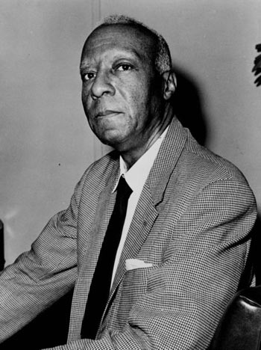
African Americans Gain Civil Rights
Double “V” campaign:
need for victory against dictators abroad & discrimination in U.S.
A. Philip Randolph:
organized protest march on Washington, D.C. & convinced FDR to issue Executive Order 8802 – assured fair hiring practices in jobs funded w/ gov’t money & est. Fair Employment Practices Committee

Slide 16
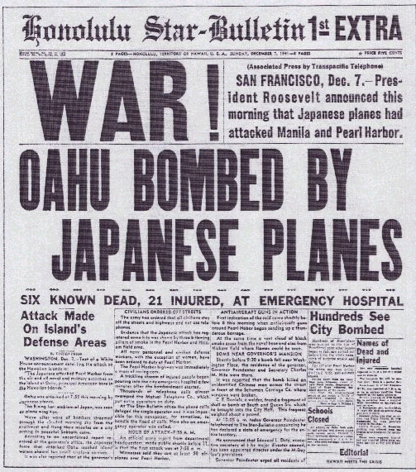
Japan Attacks Pearl Harbor
Dec. 7, 1941, Japanese planes attacked Pearl Harbor in the Hawaiian Islands.
Dropped bombs on American ships at naval base.
in less than two hours, Japan destroyed most of the U.S. Pacific fleet.
more than 2,000 sailors & 68 civilians killed

Slide 17
Challenges to Civil Liberties
Roosevelt ordered 110,000 Japanese Americans into “relocation camps” – internment
  Moved to Utah, California, Arizona, Wyoming, Arkansas, & Idaho
  Had to sell homes, businesses, & belongings
Over 17,000 Japanese Americans served in Army units even while friends & families were in camps
Korematsu v. U.S. decision upheld internment

Slide 18
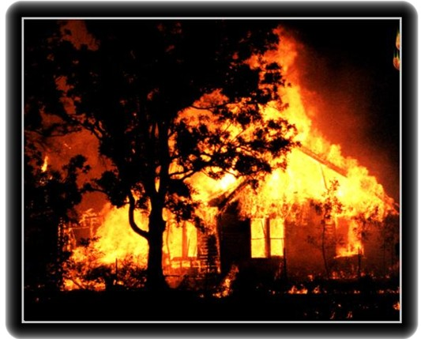
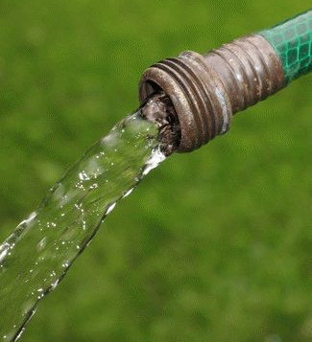
Roosevelt Inches Toward Involvement
1941, Congress passed Lend-Lease Act
allowed Roosevelt to sell or lend war supplies to any country whose defense he considered vital to U.S. safety

Slide 19
WWII: Battle of Midway
Midway
Date: 1942
Description: Japan (under Admiral Yamamoto) attempted to destroy American aircraft carriers in Pacific; Navy code breakers intercepted message & under U.S Admiral Chester Nimitz’s leadership U.S defeated Japan; * turning point of the war in the Pacific – stopped Japan’s advance

Slide 20
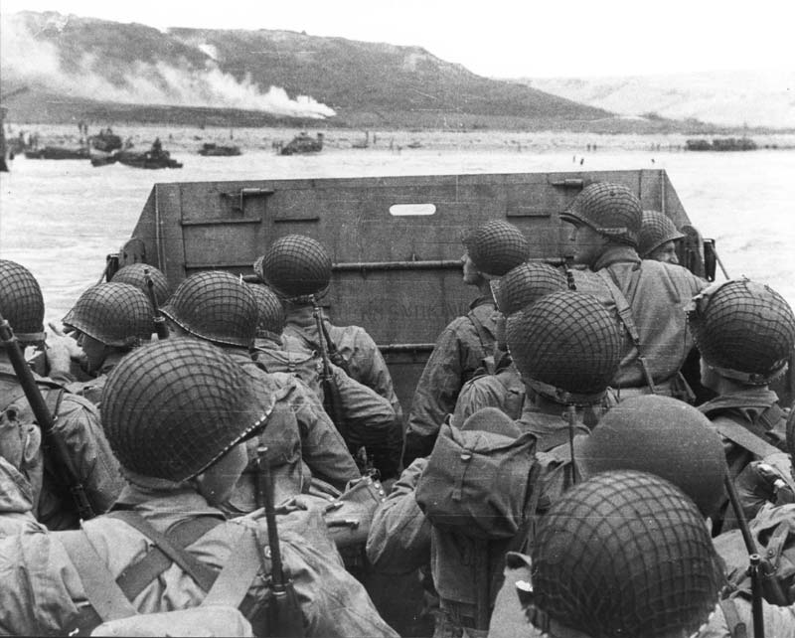
WWII: D-Day
Operation Overlord (D-Day)
Date: June 6, 1944
Description: the Allies led by Gen. Dwight D. Eisenhower landed on the beaches of Normandy, France; high American causality rates at Omaha beach; *Allies successful at gaining ground in France

Slide 21
World War II Allied Conferences
Potsdam (July ‘45)
Leaders: Harry S. Truman (U.S.), Clement Atlee (Britain), Stalin (Soviet Union)
Decisions Reached: decided to divide Germany into four zones of occupation: Soviet, American, British, & French; free elections for Poland; Soviets’ right to claim reparations for war damages from Germany

Slide 22
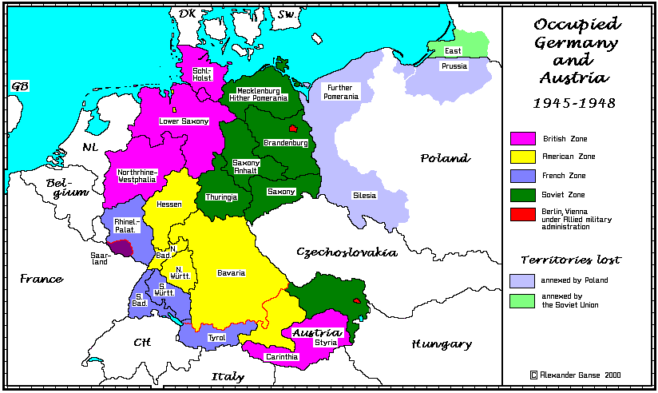
Potsdam: Division of Germany

Slide 23
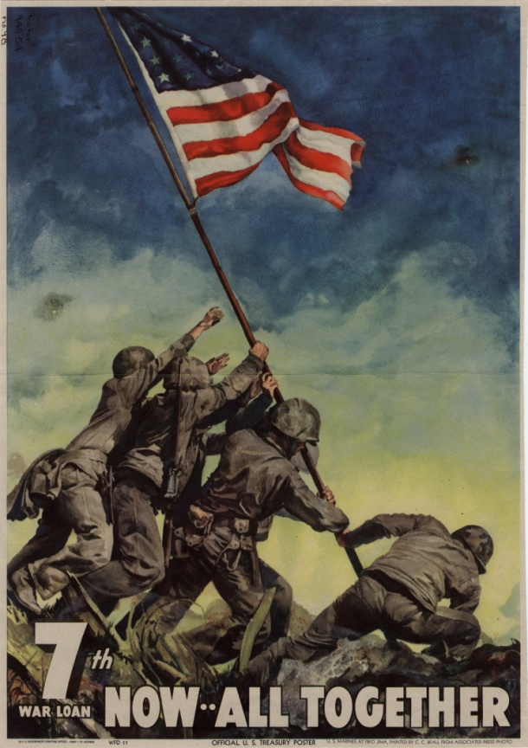
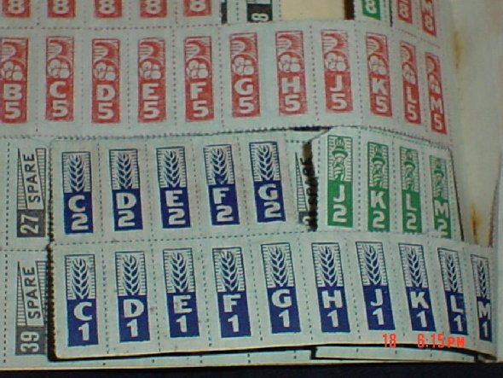
Supporting War Effort
Cost of WWII: $330 billion
Financed: imposed a 5% tax on working Americas; Americans bought war bonds
Rationing: Americans were issued coupon books that limited the amount of certain goods they could buy

Slide 24
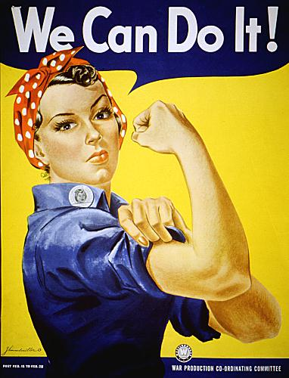
Women Work for Victory
Women’s contribution to the war:
worked in heavy industry, need for workers ended common practice of women quitting their jobs once married
“Rosie the Riveter”

Slide 25
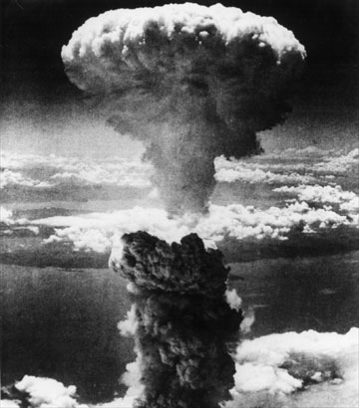
The Manhattan Project
Manhattan Project – code-name
Project leaders: General Leslie Groves & physicist J. Robert Oppenheimer
Los Alamos, New Mexico
Truman made decision to drop 2 atomic bombs on Japan to save American lives

Slide 26
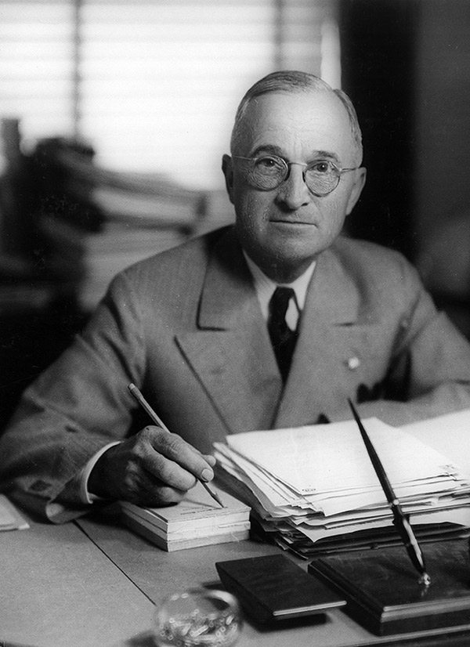
1947: Truman Doctrine announced
Truman Doctrine – Truman promised to aid nations struggling against communist movements

Slide 27
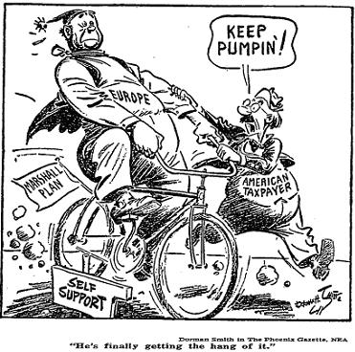
1948: Marshall Plan authorized
Sec. of State George Marshall’s plan to help Europe recover from war
Marshall Plan – economic aid for nations in Western Europe - U.S. gave money (grants & loans), food, fuel

Slide 28
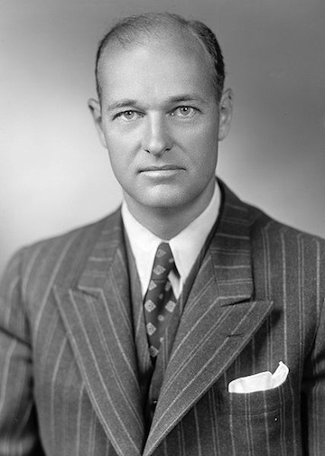
1947: Kennan outlines Containment Policy
Kennan – American diplomat & authority on Soviet Union
Containment policy – keep communism contained within its existing borders; became America’s policy

Slide 29
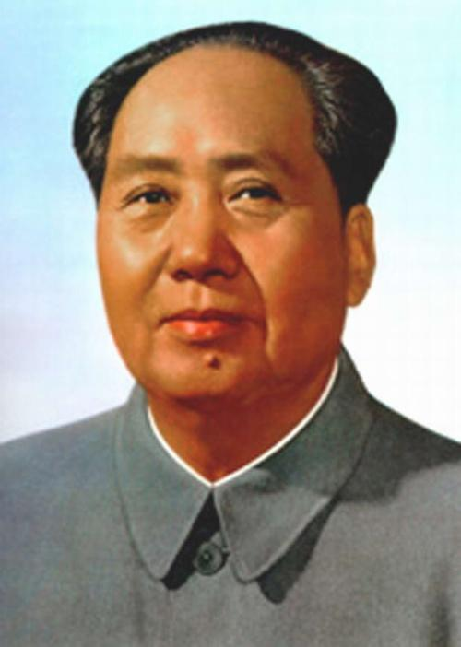
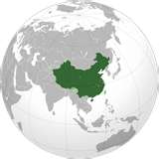
1949: People’s Republic of China proclaimed
Mao Zedong led communist forces in China against Nationalist leader Chiang Kai-shek
Mao defeated nationalist forces & renamed China People’s Republic of China – communist nation
Truman Adm. blamed for not providing enough support
Mao Zedong

Slide 30
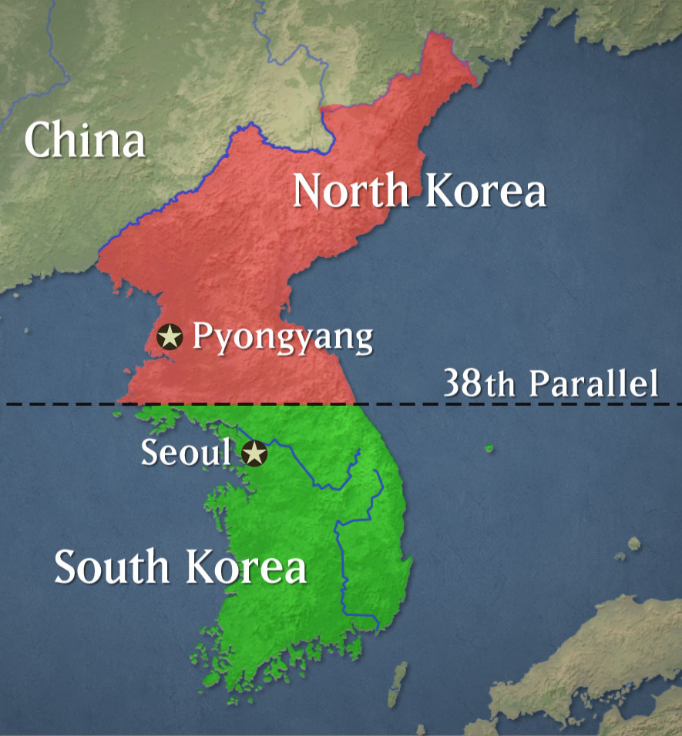
1950: Korean War begins
Korea – split at 38th parallel; North was communist, South noncommunist
N. Korea attacked S. Korea & took S. Korea’s capital, Seoul
UN Security Council voted to aid S. Korea; Truman ordered U.S. troops to S. Korea

Slide 31
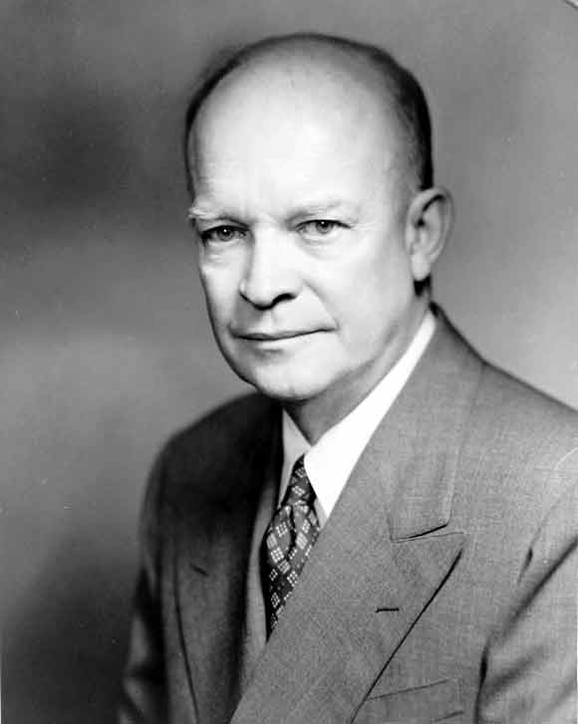
1953: Korean War ends
stalemate until 1953
Eisenhower elected U.S. President – promised to end war
cease-fire signed, division at 38th parallel restored – still in effect today

Slide 32
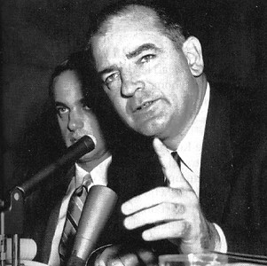
1950: Another Red Scare - McCarthyism
Senator Joseph McCarthy claimed State Department was full of communists
McCarthyism – extreme, reckless charges of disloyalty; discredited real concerns about communists in the U.S.
Red Scare declined by 1954

Slide 33
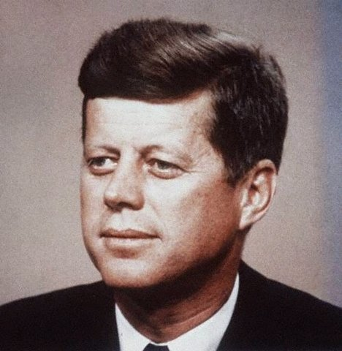
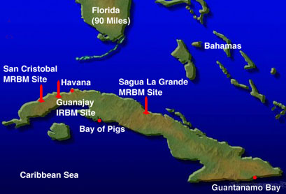
1961: Bay of Pigs invasion
1959 Fidel Castro set up a communist gov’t in Cuba
Eisenhower had approved CIA plan to invade Cuba & overthrow Castro; recruited Cuban exiles & trained in Guatemala
Kennedy executed plan – CIA-led force of Cuban exiles attacked Cuba
plan failed & many turned Cuban Americans against Kennedy

Slide 34
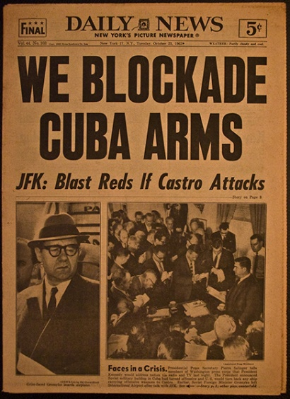
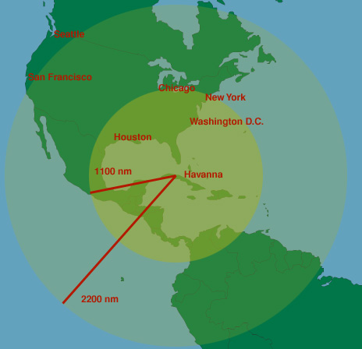
1962: Cuban Missile Crisis
U.S. discovered Soviets building nuclear missile sites in Cuba to protect Castro from an American invasion
major East Coast cities would be in range
Kennedy demanded removal of missiles & set up blockade of Cuba to prevent Soviets from completing bases
Khrushchev removed missiles
Range of Cuban missiles

Slide 35
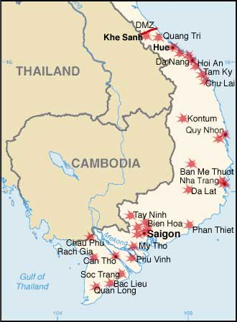
1968: Vietnam War – Tet Offensive
Tet Offensive – Vietcong’s coordinated attack on S. Vietnam; 36 provincial capitals, 5 major cities, & U.S. embassy in Saigon
American & S. Vietnamese forces stopped offensive, but demonstrated communists had not lost will or ability to fight
President Johnson announced plan to pursue peace, not victory; would not run for a second term

Slide 36
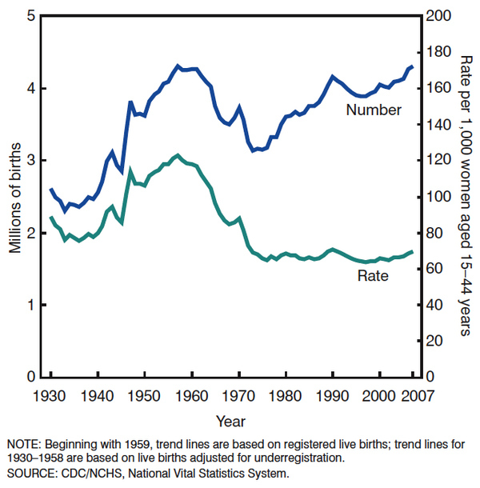
Baby Boom
increase in births between 1945 – 1964
families had put off having families during depression & war, but started having children when soldiers returned after WWII

Slide 37
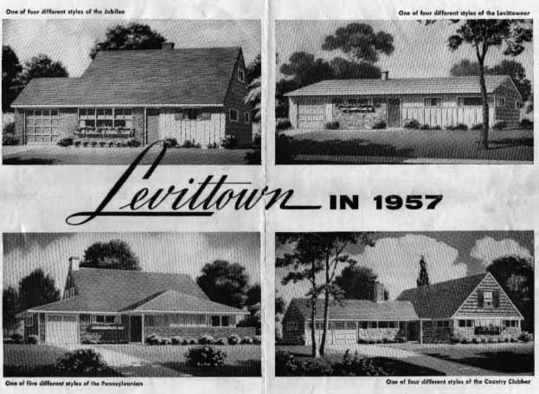
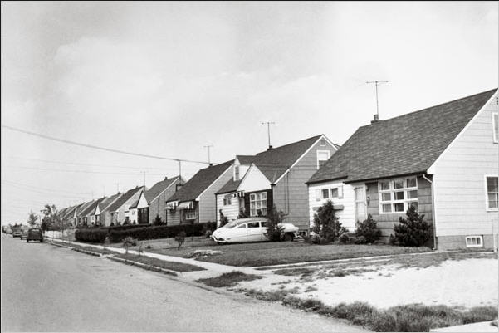
Levittown
William Levitt – mass produced suburban homes
Levittown – New York suburb that offered affordable homes ($8,000 each); demand increased & other Levittown's built

Slide 38
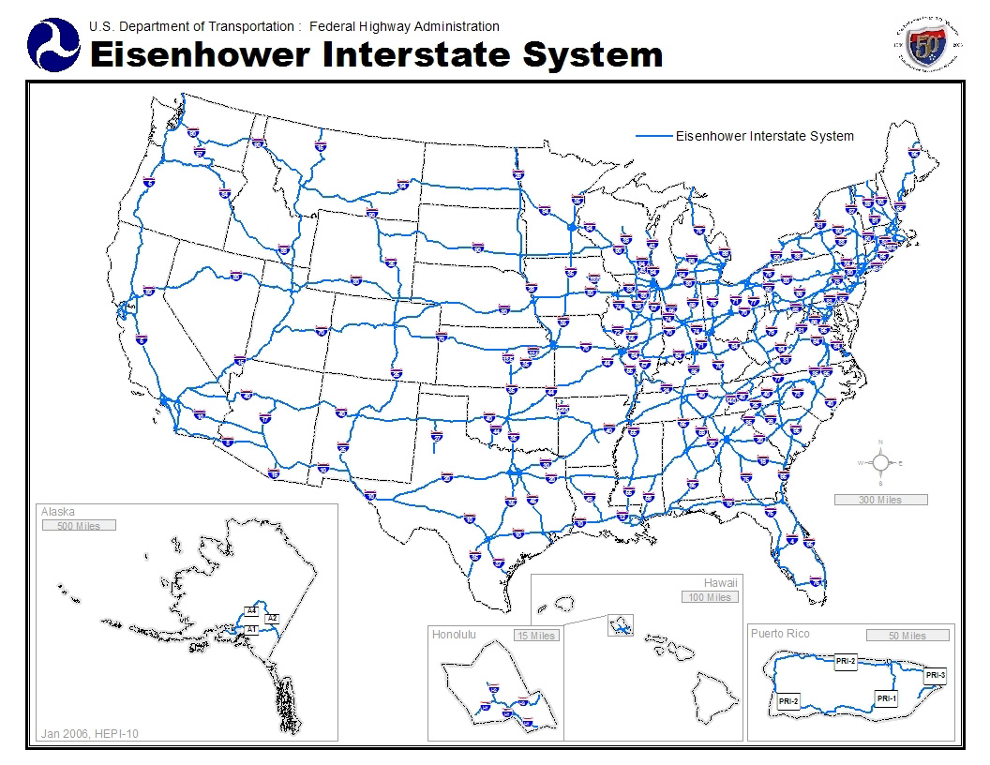
Interstate Highway Act
Eisenhower’s Interstate Highway Act – authorized spending $32 billion to build 41,000 mi. of highway

Slide 39
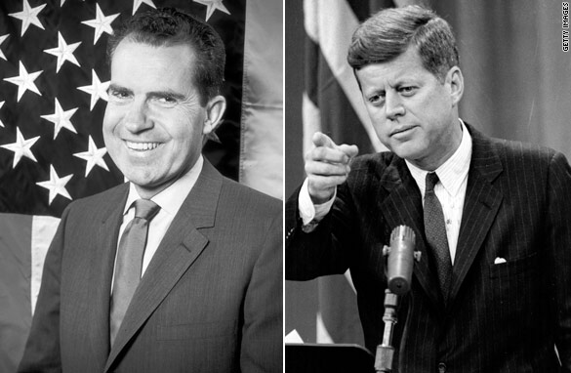
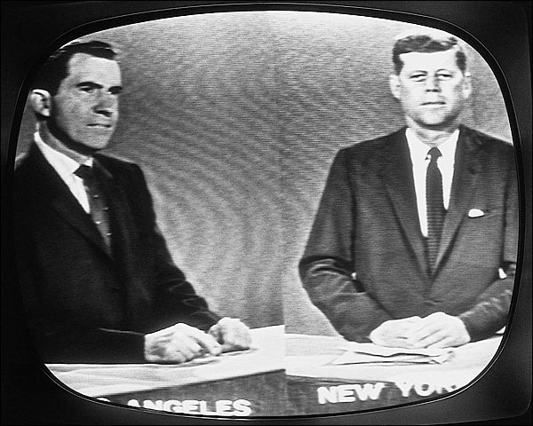
Election of 1960
Kennedy (D) v. Nixon (R)
his Catholicism worked against him
first televised Presidential debates – benefited Kennedy & probably swayed election in his favor

Slide 40
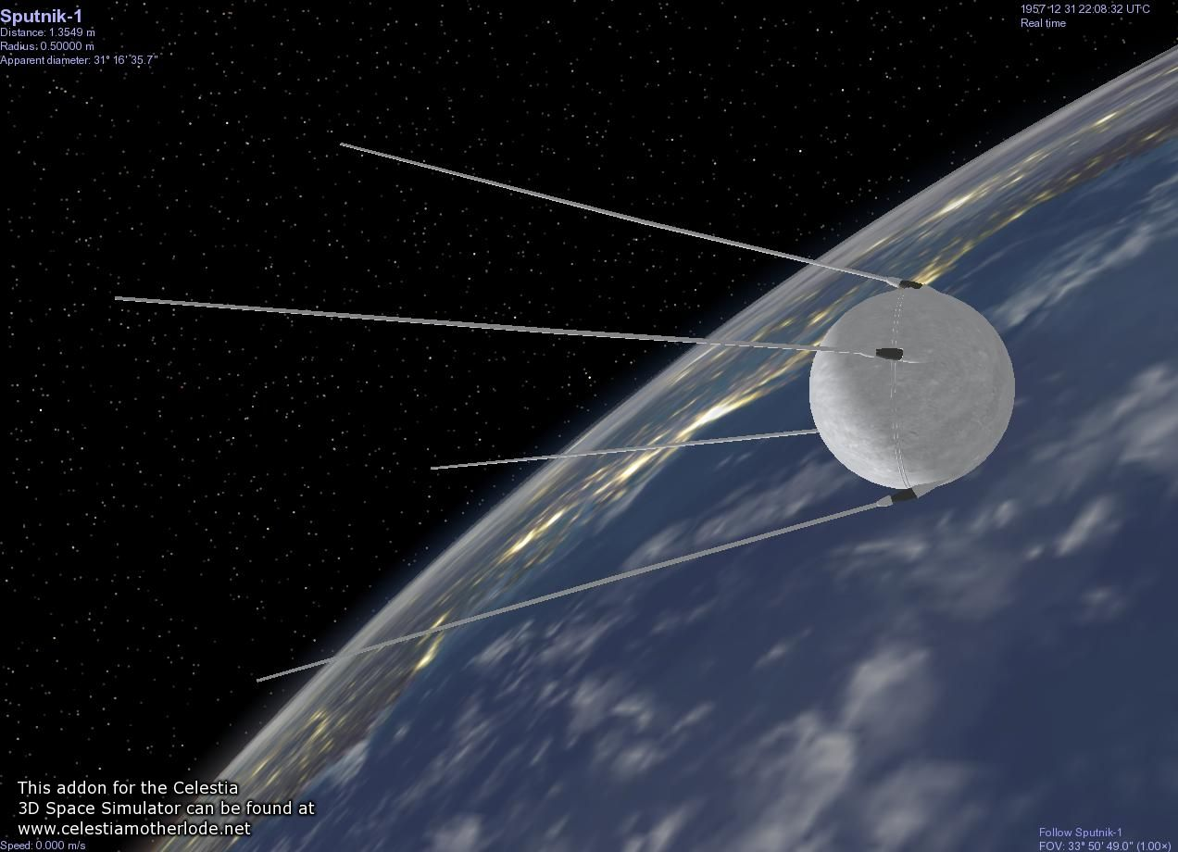
1957: Sputnik launched by Soviets & U.S. reaction
Sputnik I - Soviet space satellite
U.S. reaction
  Congress approved the National Defense Education Act - $1 billion program to produce more scientists and teachers of science
  Congress created National Aeronautics and Space Administration (NASA) to plan space-related projects

Slide 41
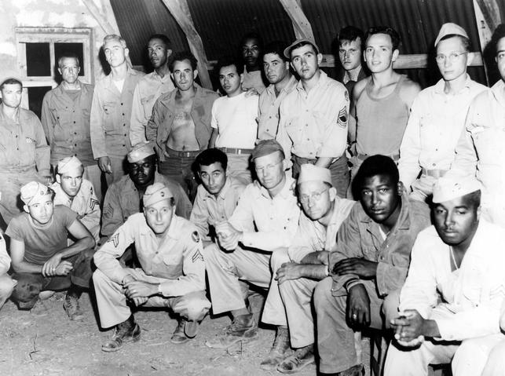
Truman’s desegregation of the military
Date: 1948
Description:
  Background: Truman appt. Committee on Civil Rights to investigate race relations; Truman attempted to implement suggestions, but Congress did not support
  Truman used executive power to order the desegregation of military

Slide 42
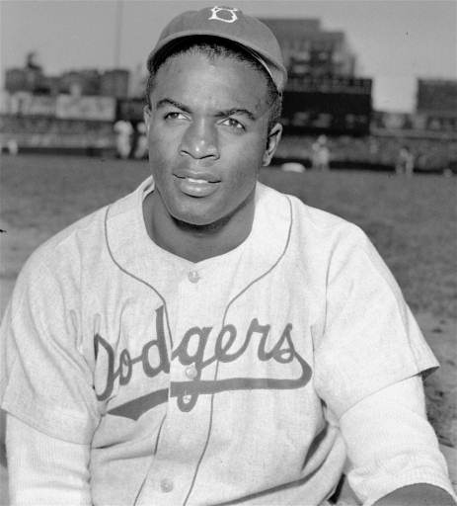
Jackie Robinson breaks the color line
Date: 1947
Description: Jackie Robinson joined the Brooklyn Dodgers becoming the first African American to play baseball in the major leagues

Slide 43
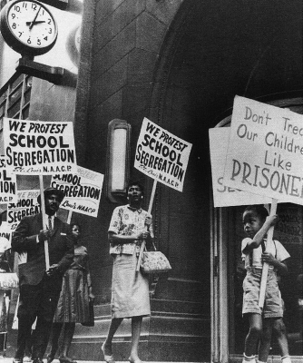
Brown v. Board of Education of Topeka, KS
Date: 1954
Description: overturned the “separate but equal” principle established by 1896 Plessey v. Ferguson case; U.S. Supreme Court decided segregated public education violated the U.S. Constitution

Slide 44
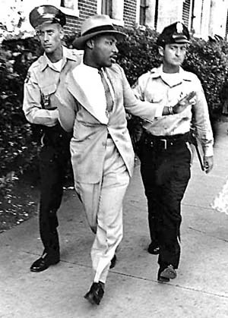
King’s arrest & Letter from a Birmingham Jail
Date: 1963
Description: King joined protesters in Birmingham and was arrested; from jail he wrote a letter explaining why civil rights activists were tired of waiting for change

Slide 45
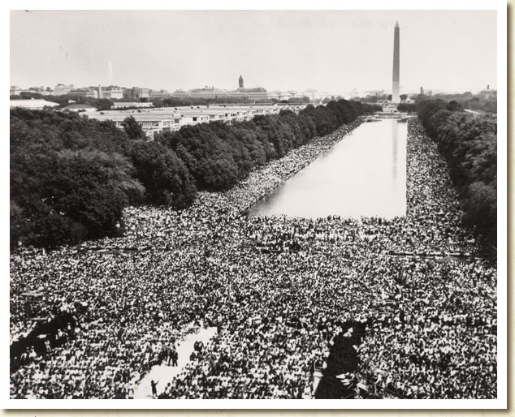
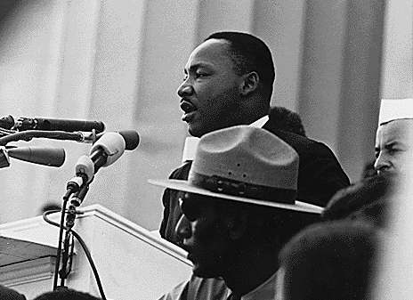
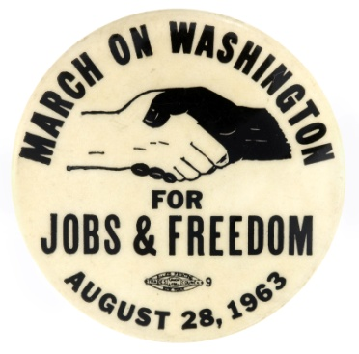
March on Washington &
“I Have a Dream” Speech
Date: 1963
Description: organized by NAACP, SCLC, & SNCC; 200,000 demonstrators marched on capital to put pressure on Congress to pass a new civil rights bill
King gave his “I Have a Dream” speech in front of the Lincoln Memorial

Slide 46
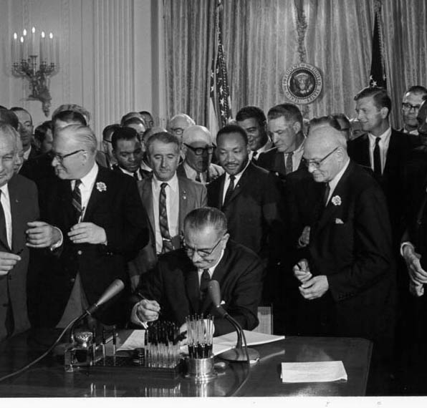
Civil Rights Act of 1964
Description: signed by Pres. Johnson (Kennedy assassinated Nov. 1963)
banned segregation in public accommodations
gave federal gov’t ability to make state & local boards desegregate their schools
allowed Justice Dept. to prosecute individuals who violated people’s civil rights
outlawed discrimination in employment – est. Equal Employment Opportunity Commission

Slide 47
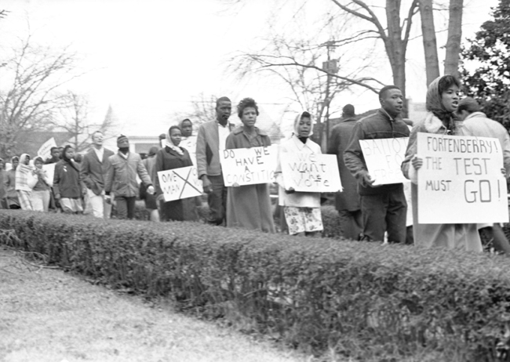
Voting Rights Act of 1965
Description: banned literacy tests & gave the federal gov’t the power to oversee voting registration & elections in states that had discriminated against minorities

Slide 48
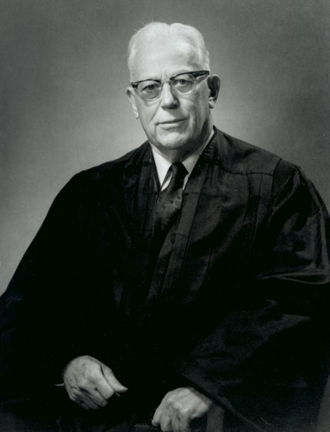
Warren Court
Chief Justice of Supreme Court - Earl Warren
nominated by Eisenhower
liberal rulings- helped expand individual rights
Brown v. Board of Ed. (’54)
Miranda v. Arizona (‘66)
  Miranda Rights – accused criminals had to be informed of his/her Fifth (remaining silent) & Sixth Amendment rights (speed, public trial before jury) before being questioned

Slide 49
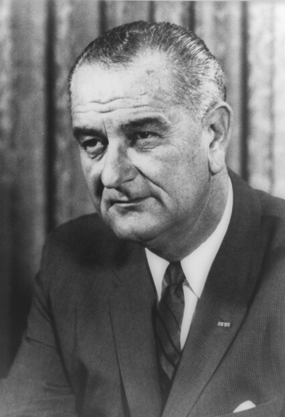
Johnson’s Domestic Highlights
“Great Society” – focused on health care, education, environment, discrimination, & poverty
  Medicare (hospital insurance for people over 65)
  Medicaid (low-cost health insurance for poor)

Slide 50


Martin Luther King’s assassination
Date: 1968
Description: assassinated in Memphis, TN on April 4th while on the balcony outside his motel room; James Earl Ray, a white ex-convict was charged with the murder

Slide 51


Robert Kennedy: Assassination
Robert Kennedy (RFK):
  JFK’s little brother
  politician & U.S. Attorney General
  civil rights activist – Civil Rights Bill
  opposed Vietnam War
  1968 Presidential Candidate
Assassination
  shot June 5, ‘68 (2 mo. after MLK) by Sirhan Sirhan, Palestinian immigrant
Democratic Nat’l Convention in Chicago (‘68) – debate Vietnam
  Antiwar protesters are beaten by Police outside convention center

Slide 52

Formation of SCLC
Date: 1957
Description: After Montgomery Bus Boycott, King & minister Ralph Abernathy est. Southern Christian Leadership Conference (SCLC) to fight for civil rights
Membership: mostly southern African American ministers
promoted nonviolent resistance

Slide 53

Formation of SNCC
Date: 1960
Description: Ella Baker, granddaughter of slaves, helped young civil rights activists form the Student Nonviolent Coordinating Committee (SNCC)
Goal: create grass-roots (community) movement that involved all classes of African Americans in pursuing equality

Slide 54


Women’s Rights Movement
1960s & ‘70s
feminism – political, social, & economic equality of men & women
Origins: began 1840s – Declaration of Sentiments, 1st feminism wave in ‘20s -Nineteenth Amendment
Nat’l Organization of Women
  Goals: pass Equal Rights Amend. to guarantee gender equality; protect reproductive rights
Roe v. Wade (‘73) – right to legal abortions in first 3 mo. of pregnancy
Betty Friedan
The Feminine Mystique
Gloria Steinem

Slide 55


Cesar Chavez &
United Farm Workers’ movement
Chavez – migrant farmworker & Latino activist, fought for rights for farm laborers (often exploited) – better working conditions
United Farm Workers – used nonviolent tactics; started
worker’s strike &
consumer boycott of grapes
successful – ’75 CA passed
law requiring collective
bargaining between
growers & union reps.

Slide 56


Environmental Movement
Rachel Carson – biologist, wrote Silent Spring (‘62) – described deadly impact pesticides were having on birds & other animals; Congress restricted use of pesticide DDT (eagles)
Earth Day – April 22, ‘70 nationwide protest org. by WI senator Gaylord Nelson; 20 million Americans participated
EPA – gov’t agency created by Congress in ’70 to clean up & protect the environment

Slide 57

Election of 1964
L. Johnson (D) v. Goldwater (R)
did not seek
reelection in
‘68 due to
divisions over
Vietnam
Goldwater marks
rise of the
Conservative
movement

Slide 58

1972: Nixon visits China
After Chinese communist revolution, U.S. never formally recognized People’s Rep. of China; Nixon wanted to - benefit U.S. economically (trade) & distance relationship b/w China & Soviet Union
Nixon made an official state visit to China – successful at opening relations w/ China
full Diplomatic relations established b/w U.S. & China in 1979
President Nixon meets with China’s Communist Party leader, Mao Zedong

Slide 59
Nixon & Watergate
Watergate Scandal
  attempted break-in of Dem. Party headquarters (Watergate complex)
  connected to Nixon
  reelection committee tried to bug office & record conversations of political opponents
Nixon resigned in 1974; Ford became President and pardoned Nixon

Slide 60
Affirmative Action
affirmative action – policy that gives special consideration to women & minorities to make up for past discrimination; ’70s - special focus on employers & schools
Bakke decision:
  Regents of the University of California v. Bakke (‘78)
  Medical school reserved spots in class for minorities
  Bakke (white, stronger academic record) not accepted & claimed racial discrimination
  Supreme Court required Bakke’s admission but did not overturn affirmative action

Slide 61

Carter’s Foreign Highlights
Camp David Accords (’78) - peace treaty between Egypt & Israel, Egypt recognized nation of Israel & Israel withdrew troops from Sinai Peninsula
Iranian Revolution (‘79) – opposition to Shah (emperor) of Iran led to the Ayatollah Khomeini seizing power, Shah fled to U.S. for cancer treatment
Iran-Hostage Crisis (Nov ’79-Jan ’81) – Iranian radicals responded by invading U.S. embassy & taking 66 Americans hostage, held for more than a year before being released – after Reagan’s election

Slide 62

Reagan’s Domestic Highlights
“Conservative Revolution”
“Reaganomics” – supply-side economics adopted – reduce taxes so people will work more, have more money to spend = economic growth

Slide 63
Reagan’s Foreign Highlights
Iran-Contra Scandal (’86) – U.S. sold weapons to Iran in ’85; in exchange, Iran promised to pressure terrorist groups in Lebanon to release Am. hostages – plan not successful & contradicted policy of not negotiating w/ terrorists; used money from weapon sales to fund Contras (anticommunists) in Nicaragua – previously banned by Congress

Slide 64

1989: Berlin Wall falls &
E. European nations throw off Communism
Berlin Wall blocked travel from communist East Berlin to democratic West Berlin
1989 – East Germany’s communist government fell; Berlin wall torn down
Communists also lost power in Poland, Hungary, Czechoslovakia, Bulgaria, & Romania in 1989; Albania in 1990; Yugoslavia in 1991
East German Border guards demolishing a section of the Berlin Wall

Slide 65

1991: Soviet Union collapses
Communist Party lost power & Soviet Union separated into 15 independent republics
Cold War ended (1945-1991)

Slide 66

Clinton’s Highlights
Free trade reappeared:
  NAFTA (North American Free Trade Agreement) (‘92) – called for the gradual removal of trade restrictions among the U.S., Canada & Mexico
Scandals:
  Lewinsky – Clinton’s affair with a White House intern, lied under oath about affair
Impeached in ’98 - acquitted

Slide 67

Election of 2000
G W Bush (R)
v. Gore (D)
Disputed election in Florida (25 Electoral College votes); Bush awarded victory in FL & therefore won Electoral College majority (by 1 vote) (Gore won popular vote)

Slide 68
September 11, 2001
Terrorist attack by Osama bin Laden’s al Qaeda network
More than 3,000 Americans died
Bush declares “war on terrorism”
American intervention:
  Afghanistan: Bin Laden believed to be hiding in Afghanistan where Taliban government let them run terrorist training camps; U.S. overthrew Taliban gov’t; held free elections & wrote a new constitution
  Iraq: believed Saddam Hussein was building & stockpiling Weapons of Mass Destruction (WMD); 2003 Operation Iraqi Freedom – U.S. forces invade; 2005 Iraq wrote new constitution

