Slide 1
EOCT Review
United States History

Slide 2
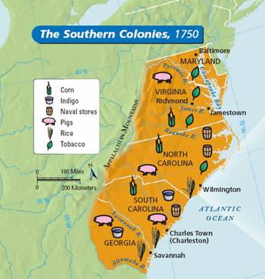
Virginia
Date founded: 1607 (1st proprietary, 1624 royal)
Founder/Group: Virginia Company
Reasons for Settlement: gain wealth for England and help with England’s population growth
Significant Facts:
Jamestown (1607)
Powhatan & Indian lands
John Smith
John Rolfe & Pocahontas
tobacco cultivation
House of Burgesses (1619)
Bacon’s Rebellion (1676)

Slide 3
Virginia Company
A corporation of London merchants
sent colonists to settle North America
1607 – colonists settled in Chesapeake Bay region (Jamestown)

Slide 4
Jamestown
the first enduring colony established by the English in Virginia

Slide 5
Tobacco cultivation
Led by John Rolfe, colonists learned to cultivate tobacco – profits attracted more immigrants to Virginia

Slide 6
Powhatan
Native American chief in Chesapeake Bay
hoped to contain colonists and use them against his own enemies
wanted to trade with colonists

Slide 7
Jamestown
Disease
especially Malaria from mosquitoes in swamps
Hunger
colonists too weakened by disease to farm
War
with Indians under Powhatan’s leadership
Stake in the land
colonists owned and worked their own land
Tobacco Cultivation
led by John Rolfe, wealth for England
Free Land
got 50 acres if your paid for your passage (or someone else’s)
Reasons for Struggle
Reasons for Success/Growth

Slide 8
Virginia’s House of Burgesses
Think about it…
What was the purpose of the House of Burgesses?
representative body – people could make laws
Who could participate in it?
male landowners over 17 years
What powers did it have?
make laws and make taxes
What legacy/trend did it start?
colonists making decisions for themselves

Slide 9
Bacon’s Rebellion
Forced onto less fertile lands in interior b/c of population growth
War w/ Indians
Gov. William Berkeley taxed heavily & gave money to wealthy
Berkeley would not let settlers attack all Indians
Settlers led by Nathaniel Bacon rebelled (1676) – burned Jamestown
Bacon died & rebellion ended
Causes
Events
Significance: showed poorer farmers would not put up w/ a gov’t that only helped wealthy

Slide 10
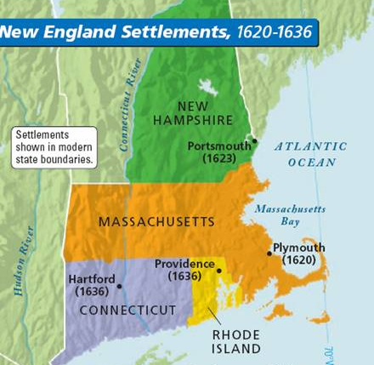
Rhode Island
Date founded: 1636
Founder/Group: Roger Williams
Reasons for Settlement: create a refuge for radical Puritans (religious dissenters)
Significant Facts:
Kicked out of Mass. Bay:
Williams – pay Indians for land
Anne Hutchinson – argued
Mass. had not done enough
to break from Anglican ways
Separation of church & state

Slide 11
New England Colonies: Key Events
Salem, Massachusetts
1692
Authorities tried, convicted, & executed 19 suspected witches
Ended when prominent citizens were accused
major Indian rebellion
1675
Indian chief Metacom (known as “King Phillip) blamed, but multiple tribes fought
Indians defeated & lost most of remaining land
Salem Witch Trials
King Phillip’s War

Slide 12
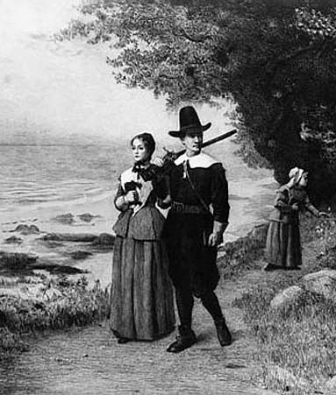
Half-Way Covenant
Created by 1662 by New England Puritans
Form of partial church membership for children and grandchildren of full members
Goal: keep current members & attract new ones

Slide 13
Massachusetts Charter
1684 - Mass. lost its charter & a new legislature established
Mass. became a royal colony in 1691

Slide 14
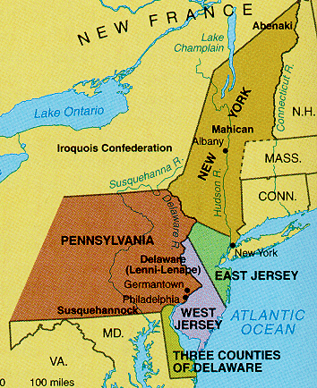
Pennsylvania
Date founded: 1682
Founder/Group: William Penn
Reasons for Settlement: debt paid to Penn by King Charles II of England; created to be a safe haven for Quakers
Significant Facts:
Quakers – followed “Inner Light” to
understand Bible, men & women
spiritually equal, pacifists,
tolerated other faiths
Peace w/ local Indians

Slide 15
Quebec – fur trade
French settlers founded the colony of Canada (New France)
trapping and fur trade important to economy
develop relationships with Native Americans

Slide 16
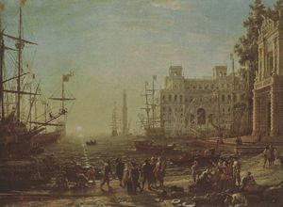
England’s Policies Toward Colonies
Government: salutary neglect – allowed colonies local self-rule
Economic: mercantilism – policy where a nation (mother country) gained wealth by exporting more manufactured goods than it imported; goal: get gold & silver through trade

Slide 17
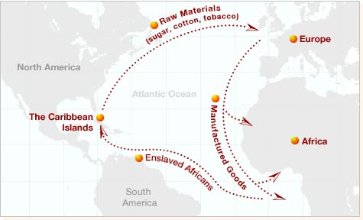
The Trans-Atlantic Trade
Three-part voyage called triangular trade
Middle Passage – forced transport of enslaved Africans from W. Africa to Americas; cramped ships, suffered inhumane treatment = 10% died
(pages 68-69)

Slide 18
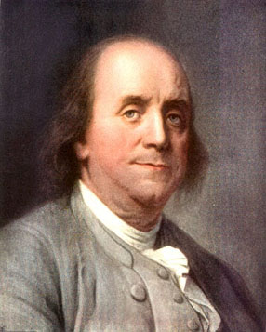
The Enlightenment
Enlightenment (1600s & 1700s) – thinkers believed that all problems could be solved using human reason; challenged old ways
Significance for Colonies:
Inspired Benjamin Franklin - scientist (invented lightning rod & bifocal glasses), political statesmen, printer, and writer of American literature (Poor Richard’s Almanac)
Represented social mobility & colonial spirit of individualism

Slide 19
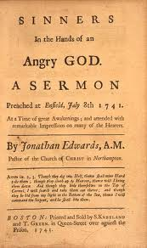
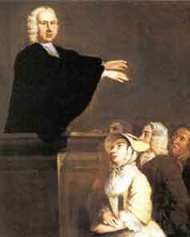
The Great Awakening
Great Awakening (mid 1700s) – religious movement that featured passionate preaching from evangelical leaders
Preachers:
Jonathan Edwards – “Sinners in the Hand of an Angry God”
George Whitefield
Significance:
encouraged colonists to think for themselves on religious matters; extended to ideas about gov’t
George Whitefield

Slide 20
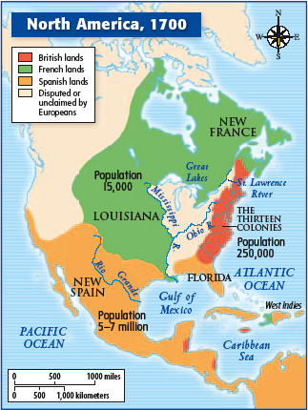
The French and Indian War: Causes
Who?
French & Indian allies v.
British/American colonists
When?
1754 – 1763
Why?
land & resources wanted by both the British & French
Ohio River Valley claimed by both
French built Fort Duquesne which angered British – start
of the war

Slide 21
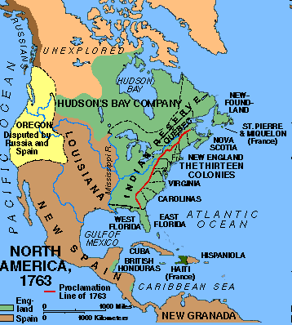
1763 Treaty of Paris
British victory; ended the French-Indian War
France lost land in N. America
British kept Canada, the Great Lakes country, the Ohio River valley, and Florida
western boundary Mississippi

Slide 22
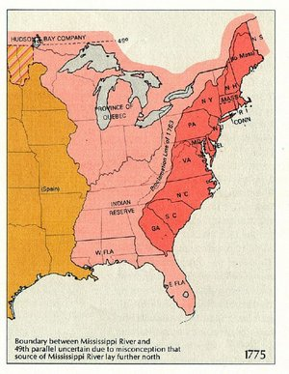
The French and Indian War
Consequences of the War:
Proclamation of 1763 – ordered colonial settlers to stay east of Appalachian Mountains; unsuccessful & irritated colonists

Slide 23
French and Indian War American Revolution
How did the French and Indian War help lay the groundwork for the American Revolution?
British sacrifices:
lives of soldiers
money to fight war
War debt – thought colonists should help pay for cost of war (new taxes)
Protecting colonists in new territories – huge additional expense
After investing so much, felt they should have more control over colonies

Slide 24
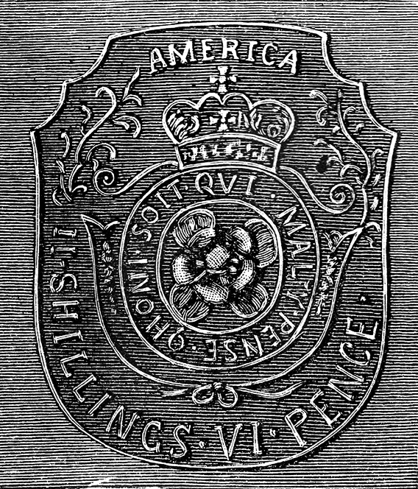
Stamp Act
1765 law passed by Parliament that required colonists to pay taxes on printed materials
first direct tax
Stamp that had to be attached to any deed, contract, bill of sale, will, etc. in America before it could be legal

Slide 25
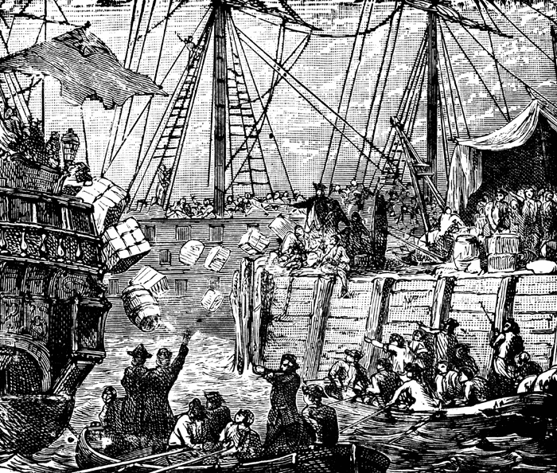
Intolerable (Coercive) Acts
1774
Passed in response to the Boston Tea Party
closed Boston’s ports, increased governor’s power, required colonists to house British troops
Boston Tea Party protesting the English tax on tea

Slide 26
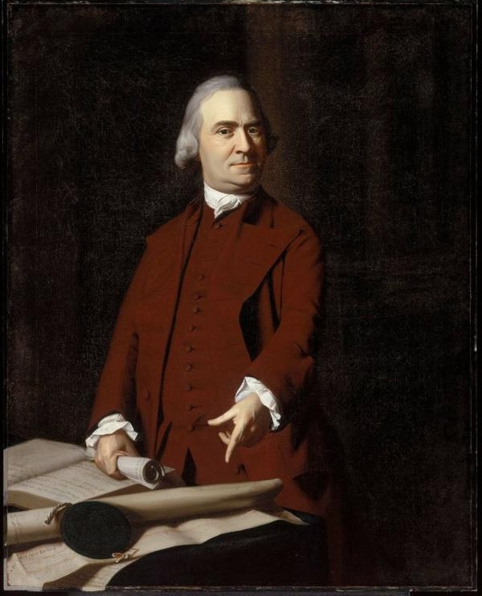
Committees of Correspondence
Began in 1770
Organized by Samuel Adams first in Mass. as a response to the Boston Massacre; provided leadership & promoted cooperation; other colonies created committees – built unity
Samuel Adams

Slide 27
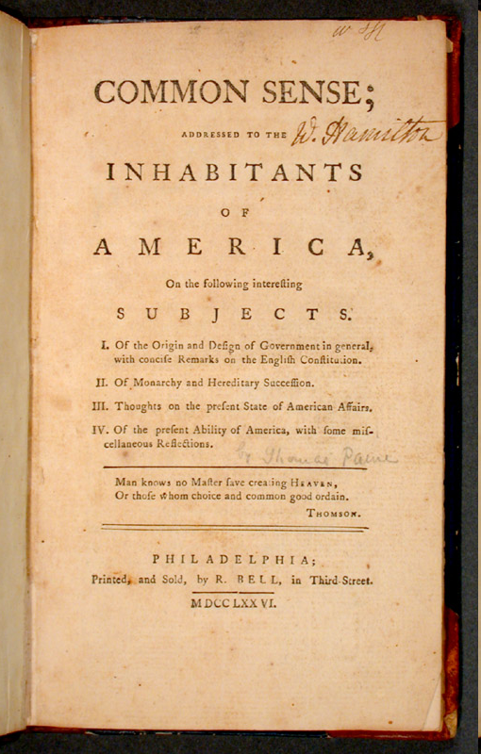
Common Sense
Thomas Paine’s Radical Proposal:
Independence from Britain, republican state governments, and a union of the new states
Wanted common people to elect all of their government
Claimed a republic would provide opportunities for social mobility (rewarding merit rather than inherited family titles)

Slide 28
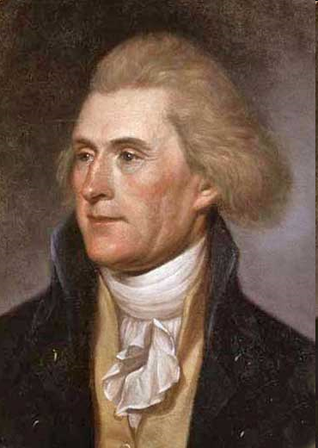
The Declaration of Independence
Drafted by Thomas Jefferson
Organization & Components:
called the king a tyrant
included list of colonists’ complaints
idea that “all men are created equal”
Enlightenment Ideas:
John Locke
all men are born w/ natural rights, “unalienable rights,” that cannot be taken away by a government
Thomas Jefferson

Slide 29
U.S. Government: 3 Branches Separation of Powers (Montesquieu)

Slide 30
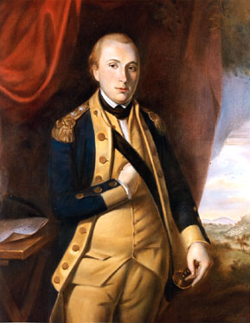
Marquis de Lafayette
French volunteer who fought for Patriots and provided military expertise

Slide 31
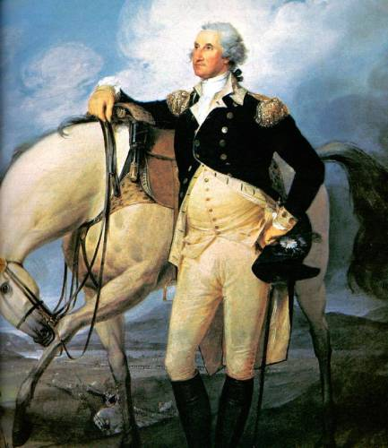
George Washington
commanded Continental Army during American Revolution
Patriots benefitted from Washington’s leadership:
Battle of Trenton
Valley Forge
Battle of Yorktown
Became first President of United States

Slide 32
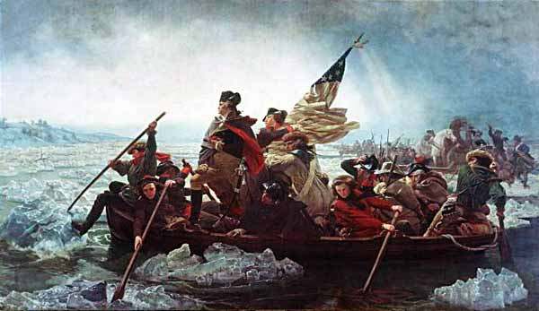
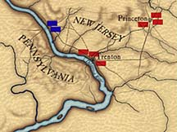
Battle of Trenton
Where? New Jersey
When? Dec. 26, 1776
What happened?
NYC captured in Sept.
George Washington
& Patriots crossed the
Delaware River to take
it back; surprised & defeated a group of 1,000 German mercenaries at the Battle of Trenton
Who won? Patriots - victory
raised morale

Slide 33
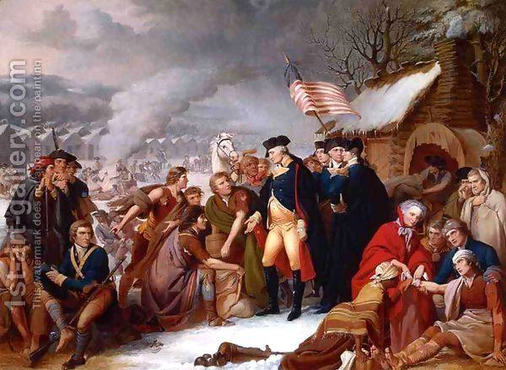
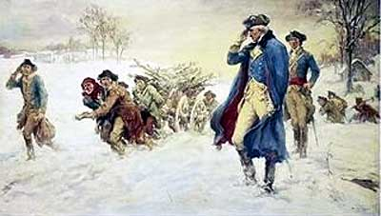
Valley Forge
Where? Pennsylvania
When? Winter 1777-1778
What happened?
Washington’s army
spent the winter at Valley Forge – harsh cold conditions, men hungry, 1/3 of soldiers had no coat or shoes

Slide 34
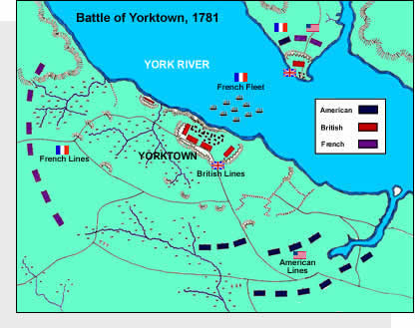
Battle of Yorktown
Where? 1781
When? Virginia
What happened?
Washington & troops planned to trap Cornwallis’s army at Yorktown; French fleet of ships arrived trapping British from
evacuating by sea
Who won? Patriot victory
Cornwallis surrendered =
end of the war
(Map - page 125)

Slide 35
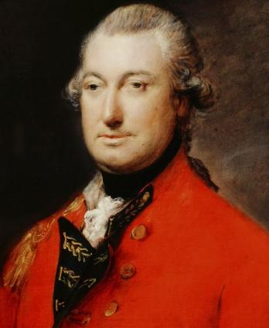
Lord Cornwallis
British General during American Revolution
Surrendered to Washington at Yorktown to end Revolution

Slide 36
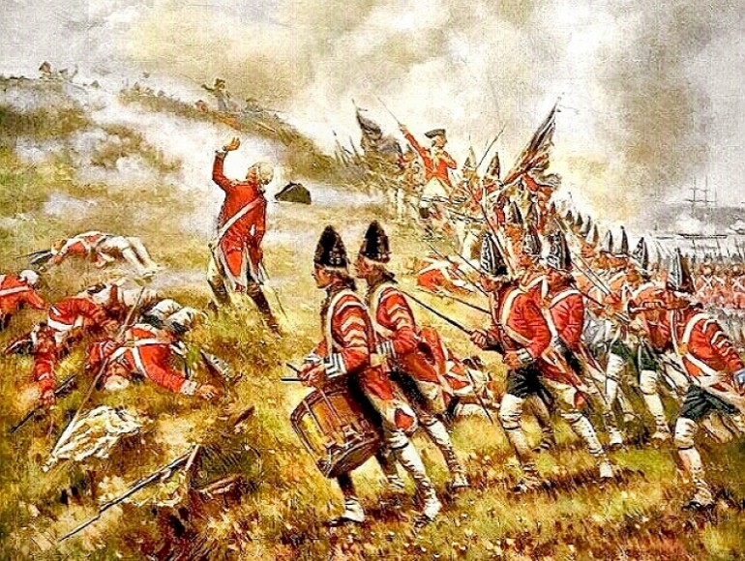
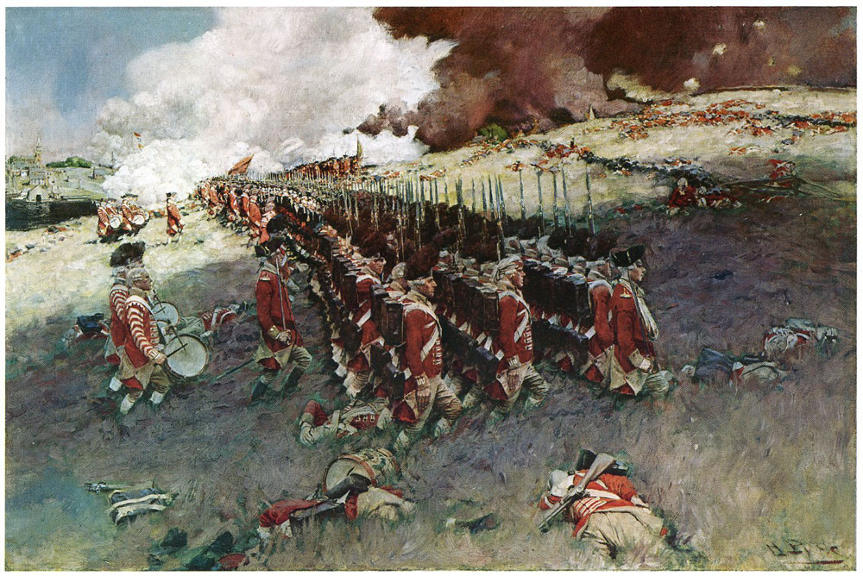
Battle of Bunker Hill
Where? outside Boston
When? 1775
What happened?
Howe ordered men to march uphill into Patriot fire in the middle of day;
captured hill b/c Patriots ran out of ammunition
Who won? British, but b/c of heavy casualties, Patriots won psychological victory
British leave Boston

Slide 37
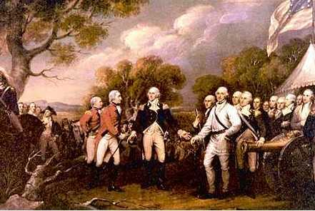
Battle of Saratoga
Where? New York
When? 1777
What happened?
colonists had lost Philadelphia (capital);
Patriots defeated British as they tried to invade NY
Who won?
Patriots
(biggest victory &
turning point of
the war)

Slide 38
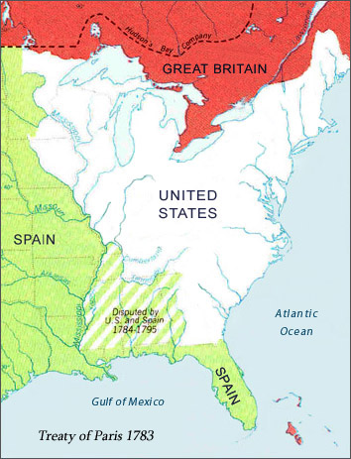
The Treaty of Paris (1783)
American delegation including (Franklin) negotiated a treaty with Britain
1783 Treaty of Paris:
recognized American independence
set U.S. boundaries
(map – page 126)

Slide 39
Weakness of the Articles of Confederation
Tax Power
Currency Powers
Commerce Powers
(trade)
Court System
No executive branch to enforce laws
Could NOT raise money by taxing
Could NOT establish a common currency
Could NOT regulate trade
There was NO system of federal courts

Slide 40
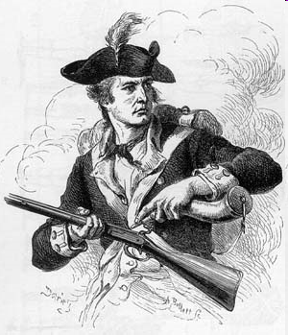
Shay’s Rebellion
W. Mass. 1786 farmers took up arms to shut down courts to stop any foreclosure hearings – leader Daniel Shays
1787 led 1,000 farmers to seize weapons from the Springfield Armory and again attempted to shut down the courts – Shay’s Rebellion

Slide 41
Anti-federalists vs. Federalists
Anti-federalist concerns
Constitution gave national gov’t too much power
President will be just like a king
Individual liberties of people will be threatened by a powerful gov’t
Jefferson
Federalist response
enough power to solve the country’s problems
system of checks and balances will limit president’s power
Bill of Rights will protect citizens freedom
Hamilton & Madison

Slide 42
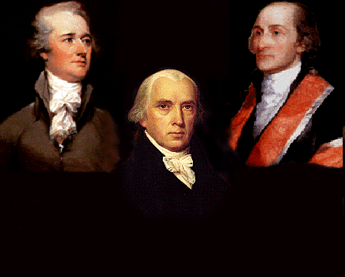
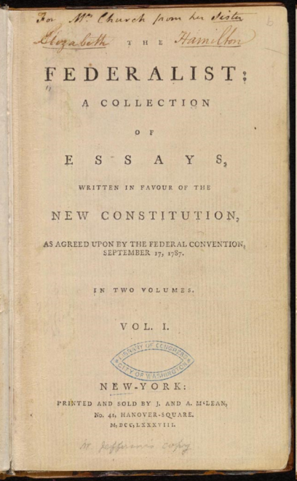
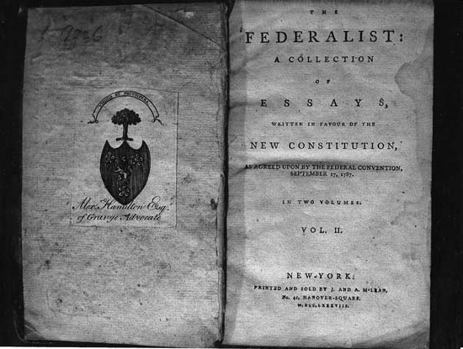
Why The Federalists Won
The Federalist Papers (Madison, Hamilton, Jay)
85 essays written to persuade NY to ratify the Constitution
Agreed to add a Bill of Rights – 1st ten amendments to the constitution; written list of freedoms guaranteed to citizens by the government – protects individual and states’ rights
Alexander Hamilton
John
Jay
James Madison

Slide 43
Separation of Powers: Checks and Balances (Monteseuieu)
Executive Branch
President
Carries out the Laws
Can remove president from office
Can Override Presidential Veto
Legislative Branch
Congress
Makes the Laws
Can veto acts of congress
Can declare acts unconst.
Can appoint judges to Sup Court
Can refuse to appoint judges
Can declare acts unconst
Judicial Branch
Supreme Court
Interprets Laws

Slide 44
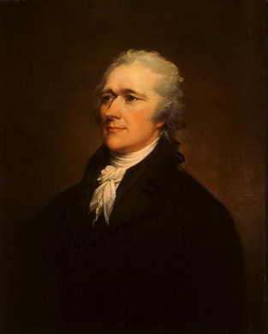
Alexander Hamilton
Conservative
disliked democracy (preferred British model)
Important during the creation & adoption of the Constitution
Would later become 1st Secretary of the Treasury

Slide 45
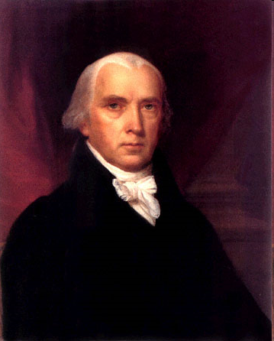
James Madison
“Father of the Constitution”
favored a republic rather than the British system
wanted government that was both strong
wanted well educated to govern
Important during the creation & adoption of the Constitution

Slide 46
Constitution Comprmises: The Great Compromise
Created a bicameral legislature
Legislative Branch
House of Representatives
(based on state’s population)
Senate
(2 senators from every state)

Slide 47
2 Political Parties
Federalists
Loose interpretation: implied powers of Constitution
Pro U.S. Bank & Hamilton’s plan (taxes)
Pro British
Urban, industrial nation
Thought the educated elite should run the gov’t
Democratic Republicans
strict interpretation: gov’t only has powers stated in Constitution
Anti-U.S. Bank
Pro French
Rural, agricultural nation
Supporter of the “common man”
Wanted to decrease the size of the army & navy
strong state power
Leader: Alexander Hamilton
Leader: Thomas Jefferson

